Slide 1
Transportation Electrification in Vermont
Vermont Energy Future Initiative
Notes:
This presentation was prepared for the Energy Action Network’s Vermont Energy Future Initiative. Dave Roberts of VEIC was the lead for compiling this research and presentation. Additional assistance was provided by Karen Glitman (EAN Sr. Fellow), Linda McGinnis (EAN Sr. Fellow), Jennifer Wallace Brodeur (VEIC), Philip Picotte (VEIC), Sarah Wolfe (EAN Staff), and Jared Duval (EAN Staff).

Slide 2
AGENDA
Transportation Emissions
EV Market Status
EV Economics and Incentives
Accelerating Adoption
Opportunities and Case Studies

Slide 3
EMISSIONS
Notes:
To reiterate, how we get around and heat our homes and buildings are our two biggest sources of GHG emissions, together causing over 70% of Vermont’s climate pollution.
Transportation is also single largest sector of energy consumption in Vermont (44% in 2017)

Slide 4
EMISSIONS
Health and Climate Impacts of Emissions
$18.42 in Impacts per 16-Gallon Tank of Gasoline
Estimated total health and climate costs of vehicle pollution in Vermont was $347 million annually in 2015
American Lung Association 2016
Notes:
https://www.lung.org/local-content/california/documents/2016zeroemissions.pdf
Health Costs = Valuations used by US EPA in Regulatory Impact Work
Lepeule (2012), Krewski (2009), Pope (2002), Laden (2006)
Asthma, premature death, etc
Climate Pollution = Social Cost of Carbon
US Interagency Working Group (2015)

Slide 5
PATH TO PARIS
Top 10 VT Drivers to Meet the Paris Agreement
2.53 MMTCO2e reduction by 2025
Notes:
Based on 2015 data, we would need to reduce emissions by 2.53 million metric tons of CO2 equivalent (MMTCO2e) by 2025.
This analysis by EAN is based on proven and available technologies, and peer-reviewed data about how much pollution reduction we can get from various strategies.
This shows one possible path forward. Getting to Paris would require ALL of these efforts, plus 20% more from additional measures. For example, if Vermont put fewer than 90,000 new EVs on the road by 2025, we would have to make up the difference in another area in order to meet the commitment.
EAN also broke down the annual adoption rates needed to reach this path for the top four drivers: EVs, heat pump systems, advanced wood heat systems, and building retrofits. (Note: we did not break down increasing non-EV fleet MPG, even though it has a larger potential benefit than weatherization, since that is largely regulated by standards from the federal government or larger states such as California).

Slide 6
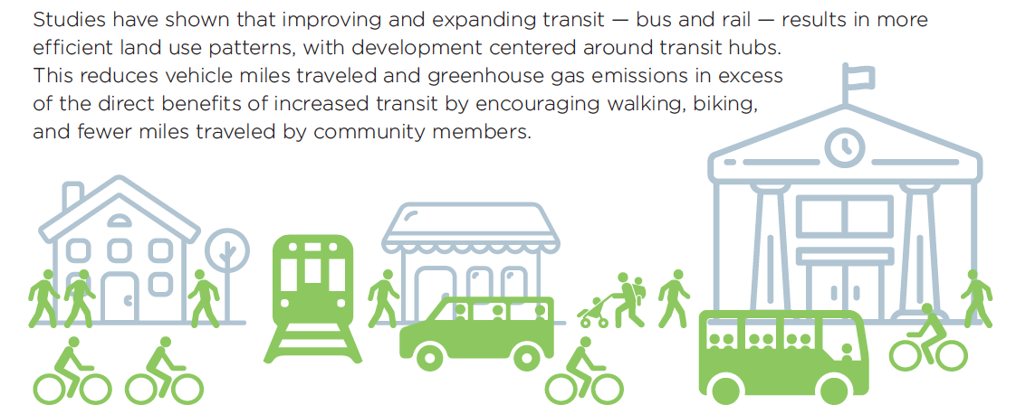
Reducing Vehicle Travel
Walking, Bicycling, Carpools, Transit, Telecommuting
Land use patterns are a critical ingredient
Improved health, lower emissions and cost
Go! Vermont, RPCs, Municipalities, etc
Notes:
Important to continue work on reducing vehicle travel – efficiency first
Tough nut to crack in Vermont, with a rural population that is accustomed to getting around with cars
Vehicle Miles Traveled (VMT) increased 4.3% between 2013-2017; per capita VMT also up 4.6%; overall VMT still down 6% from 2003 peak – recession/economics can significantly reduce, as well as demographics (fewer children, school trips, etc)
Secondary benefits of increasing transit could result in up to three times as much reduction in carbon emissions as the primary impacts.
Vermont is also furthering the benefits of transit by working to electrify buses – 2 expected in Burlington this fall, 2 more in Montpelier area next year, more on this way with VW mitigation funded pilot for electric school and transit buses – RFQ responses due August 16.

Slide 7
Path to Paris – EV Growth
What does that look like over the next six years?
Year | # of additional electric vehicles /year
2019 | 1,812
2020 | 2,989
2021 | 4,932
2022 | 8,138
2023 | 13,427
2024 | 22,153
2025 | 36,550
Notes:
Paris agreement would require about 27% reduction in GHG emissions below 2005 levels (currently down 2%)
To reach 90,000 electric vehicles displacing that many fossil fueled cars by 2025, approximately one third of all vehicles sold over the next six years would have to be electric.
For context, there were around 44,000 new vehicles sold in Vermont in 2018. If those numbers hold steady, Vermonters will buy 264,000 new vehicles between now and 2025.
This graphic shows a 65% year over year growth rate and assumes a 50/50 split between all electric vehicles (AEVs) and plug-in hybrid electric vehicles (PHEVs) by 2025.

Slide 8
Vermont Market Conditions

Slide 9
Vermont Vehicle Registrations
497,000 “on-road” vehicles registered and titled as of June 2019
94% of vehicles fall into automobile or truck categories
71% auto; 23% truck
48% of registered vehicles were purchased new
Median vehicle age is 6 years old
1/3 are 3 years or less
1/4 are 10+ years
Notes:
Other vehicle categories include buses (but not school buses), municipal vehicles, and a few more esoteric types; does not include off-road vehicles like agricultural equipment, snowmobiles, etc.
Truck category on this slide is based on DMV registration classes (different definition of truck than the sales data later in this presentation); SUVs are generally not considered trucks in the DMV registration data; some trucks may be registered as autos; 114k total
Most trucks are Class 1-2 light trucks (under 8,500 lb)
Small number are “heavy trucks” over 25k lb
One fourth of our vehicles are 10 or more years old and could be great targets for pollution reduction programs (e.g. cash for clunkers) to help direct benefits to lower income / rural populations

Slide 10
Top 10 Vehicle Model Registrations
UVM TRC, VTrans 2017
Notes:
From the 2017 Vermont Transportation Energy Profile
https://vtrans.vermont.gov/sites/aot/files/planning/documents/planning/The%20Vermont%20Tranportation%20Energy%20Profile_2017.pdf
4 of the top 10 are pick-ups; 9 out of 10 potentially have AWD/4WD

Slide 11
Market Data
About 2/3 of sales are used vehicles
VT DMV
Notes:
Usually around 100k total annual sales
Based on VT DMV vehicle title data reporting

Slide 12
Vermont Annual New Vehicle Sales
VT VADA
Notes:
https://www.vermontada.org/industry-information.html
Somewhat higher NEW sales numbers than DMV in prior slide. Potentially vehicles heading out of state or otherwise not titled and registered in VT.
Trend toward larger SUV/truck types of vehicles – over the past 4 years gone from 69% to 80% (11% market share increase in just 4 years)
This data classifies light trucks/SUVs different from DMV truck registrations. VADA sales data is based on industry terms for light trucks, which includes pick-up trucks, SUVs and crossovers. The DMV data is pick-up trucks and larger.

Slide 13
Vermont Electric Vehicle Registrations
30% Annual Growth Rate
Vermont Energy Plan
Paris Agreement
VT ANR, VT DMV, EAN
Notes:
Total EVs registered
About 2/3 plug-in hybrids
About 15% used purchases
Right now trending to about 30% annual growth – (about 15k EVs by 2025) need to boost that to about 65% annual growth to meet Paris agreement
Paris agreement 90k EVs based on EAN analysis – assumes ½ all-electric and ½ PHEV

Slide 14
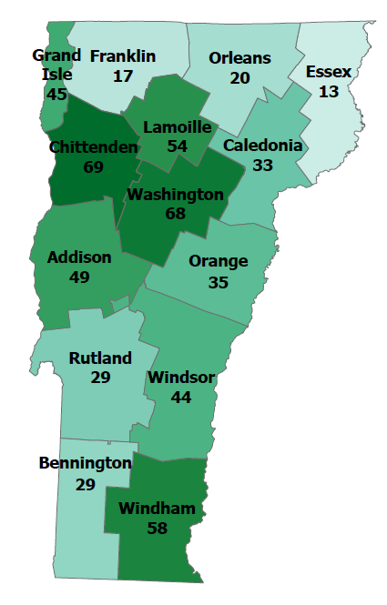
Electric Vehicles per 10,000 People by County
VT ANR, VT DMV, VEIC, EAN
Notes:
https://www.vtenergydashboard.org/statistics
Note: statistics as of Dec. 2018.
Urban communities tend to have more suitable travel patterns for EVs and also have higher incomes
Some rural areas have seen greater adoption with the participation of local dealers – e.g. Lamoille County

Slide 15
Public Electric Vehicle Charging Infrastructure
Annual Increase in Public EV Charging in Vermont
US DOE, VEIC
Notes:
Total of about 220 locations; about 25 DCFC, but with variety of plugs
VT has high rate of charging per capita / per EV, but many more will be needed
US DOE EVI-lite tool estimates 1,000 L2 plugs and 190 DCFC plugs for 50k EVs in VT
https://afdc.energy.gov/evi-pro-lite
Need more fast charging, but it is expensive to install (starts at about $50k in most instances and higher powered equipment able to serve multiple vehicles at once can be much higher)

Slide 16
EV Economics and Current Incentives

Slide 17
Statewide EV Fuel Cost Savings
US EIA, VEIC
Notes:
Total expenditures from EIA state data for gasoline and diesel (distillate fuel oil) transportation expenditures. Gas and diesel costs have decreased primarily due to price fluctuations (they are unregulated fuels), but even at lower prices going electric can provide significant savings.
Estimated EV costs based on VTrans statewide VMT data, avg annual residential electric rate (could be significantly lower with utility off-peak charging programs) and avg. EV efficiency of 0.33 miles/kwh (likely not as accurate for heavy duty vehicles, so this should just be considered a rough “what if” estimate)
EIA data from https://www.eia.gov/state/seds/data.php?incfile=/state/seds/sep_prices/tra/pr_tra_VT.html&sid=VT

Slide 18
BENEFITS
Individual savings up to $10,000 over 150,000 miles
Notes:
Let’s start with EVs – many people may be aware of the comparison between what it costs to fill up your car with gas versus with electricity. At current rates, it’s about a $1.50/gallon equivalent, not taking into account rate design that could provide more favorable prices for charging in times when the electric grid has excess capacity (off-peak).
But many people still don’t realize that electric vehicles also require a lot less maintenance. Between maintenance and operations savings, an electric vehicle driver can save as much as $10,000 over 150,000 miles. This is just a short list of some of the most common recommended maintenance items and the relative costs for EVs or gas vehicles.
And when you spend a dollar on electricity, two to three times more of that dollar stays and recirculates in the Vermont economy than if you spend it on fossil fuel.

Slide 19
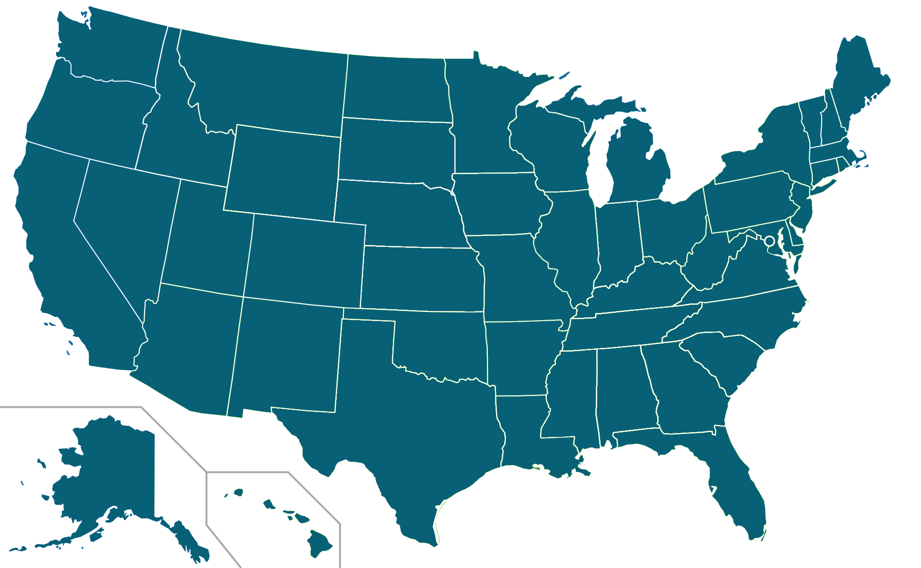
Fossil Fuel Subsidies
Fuel prices don’t cover the full cost of production and consumption.
Direct Subsidies
US: All Fossil Fuels $649 billion / Year
R&D funding
Special tax treatment
Low royalties on extraction
Indirect Subsidies
Vermont: Gasoline Only $327 million / Year
= $603 per gas vehicle
$1.04 per gallon of gas
Supply chain security expenses
General taxation transfers to Highway Trust Fund
Costs Imposed on Others
Air pollution health costs (asthma, cardiovascular disease)
Climate change damages
Source: International Monetary Fund estimate (May 2019), apportioned to Vermont gasoline sales based on US EIA data and UVM TRC Vermont Transportation Energy Profile.
Notes:
https://www.imf.org/en/Publications/WP/Issues/2019/05/02/Global-Fossil-Fuel-Subsidies-Remain-Large-An-Update-Based-on-Country-Level-Estimates-46509
Translates to Vermont at $603 per vehicle annually
Energy security costs not included in IMF estimate as they are “not well defined”

Slide 20
EV Federal Tax Credit
Up to $7,500 credit claimed as part of income tax filing (credit – not a deduction)
Begins sunsetting at 200,000 EV sales by individual automaker
Tesla and GM have already had incentive reductions
Not everyone has enough tax liability to take advantage
Leasing makes it easier to get at least a portion of the credit
https://www.irs.gov/businesses/irc-30d-new-qualified-plug-in-electric-drive-motor-vehicle-credit

Slide 21
Electric Utility Incentives
Vermont electric utilities are offering a variety of EV incentives to meet renewable energy standard obligations to reduce customer fossil fuel use
$500-1,500 for all-electrics
$250-1,200 for plug-in hybrids
Up to $1,000 additional for low and moderate income
Some offering additional incentives for smart charging equipment
Some offering incentives on used vehicles
See DEV website
for details
http://www.driveelectricvt.com/buying-guide/purchase-incentives
Notes:
Utilities also offering incentives for electric mowers and funding assistance for electric buses

Slide 22
Combined Incentive Example
Description | Nissan LEAF 150 Mile Range | Nissan Sentra
Starting Price | $29,990 | $17,890
Federal Tax Credit | -$7,500 | --
Nissan Utility Customer Discount | -$5,000 | --
Electric Utility Incentive | -$1,500 | --
Price after Discounts | $15,990 | $17,890
Notes:
Example of LEAF compared to Sentra
LEAF has Nissan corporate discount which makes this comparison more attractive. Some utility discounts are higher for low-and-moderate income customers.
When combined with fuel and maintenance savings, an EV can more than pay for itself. Especially true if you get a good deal on a used EV.

Slide 23
Vermont State Incentives
The 2019 Transportation Bill (H.529) included at least $1.1 million for an EV incentive program to be administered by VTrans
Eligibility will be limited to:
New vehicles with base pricing of $40,000 or less
Households with annual income below about $92,000 (officially 160% of the state area median household income)
Anticipated program launch in late 2019
https://vtrans.vermont.gov/planning/projects-programs/electric-vehicles
https://legislature.vermont.gov/bill/status/2020/H.529
Notes:
Likely amount between $2,500 and $5,000
Incentive amount may vary for PHEVs
Initial $1.1M funding from separate VW consumer protection settlement might cover around 400 vehicles
Vtrans tasked with reporting back to legislature on experience and potential future funding sources
As mentioned earlier, the state is also working on electric bus incentives.
Potential LMI incentives for used EVs through emissions repair program

Slide 24
EV Charging Rate Design Opportunities
EV Time-of-Use and Demand Response programs can reduce costs by 50% or more while supporting all ratepayers through more efficient use of grid resources
Green Mountain Power eCharger Pilot
August 2018 Demand Reduction Event
Peak Demand Reduction
Baseline
GMP VT PUC Presentation
Notes:
GMP pilot – customers share access to Level 2 home charger to manage load to benefit all customers
Customers get free level 2 charging equipment with EV purchase / lease and receive peak notifications sent out 8-24 hours in advance
Notification includes option to opt-out of demand reduction if customer needs to charge during that time
Working well with less than 5% opt-out rate
August 2018 peak – 29kW curtailed = $3,391 saved
Utilities are exploring TOU rates integrated with these types of programs to reduce the customer’s cost of charging by 50% or more while still benefiting all ratepayers and putting downward pressure on electric rates by leveraging existing grid investments.

Slide 25
Accelerating EV Adoption

Slide 26
Vermont Barriers to EV Ownership
Price mentioned more than twice as often as any other barrier
VEIC 2016
Notes:
Many of these factors are changing, although consumer awareness of these changes is not always there
Prices are lower, range is up, public charging options have increased, AWD is available and more models are coming
Next slide summarizes some of these in context of broader market transformation opportunities
Can note that range and charging are variations on the same theme and, when combined, are roughly equal to price

Slide 27
Vermont Barriers to EV Ownership
Household
Income
EV Price Barrier Ranking by Household Income
Price was a top barrier for more than half of lower income households
VEIC 2016
Notes:
Range of vehicle and suitability in VT conditions (e.g. AWD) were distant second and third ranked barriers for HHs with income less than $50k.
Home charging availability was a lower ranked barrier in the survey, but is a significant issue for many low-and-moderate income households, especially if they are in rental housing and/or do not have dedicated off-street parking available

Slide 28
EV Market Transformation
Incentives
Equity-based Policies
Marketing – Consumer & Dealer Programs
Technology – new models, lower cost
Charging Infrastructure Investments
Fleet EV Adoption
Notes:
Some of the primary ways we can advance EV adoption

Slide 29
Incentives Matter - Georgia Example
All-Electric Vehicle Sales Georgia Monthly Market Share
Elimination of $5,000 state income tax credit
Auto Alliance AT Sales Dashboard
Notes:
From Auto Alliance dashboard
https://autoalliance.org/energy-environment/advanced-technology-vehicle-sales-dashboard/
Share plummeted when incentive program was rescinded in 2015. Had been offering $5,000 state tax credit on all-electrics.
Doubly painful with start of new EV fees at same time
https://www.utilitydive.com/news/georgia-electric-vehicle-sales-shrink-80-in-wake-of-tax-credit-repeal/434092/

Slide 30
Incentive Design Considerations
What is the best way to spend limited funds for incentives?
Eligibility restrictions to reduce free ridership
Income-based requirements add significant complications
Price caps are easier to administer
Incentive amount high enough to influence a purchase
Typically around $2,000 for US state programs. Higher incentives drive more sales
Simpler is better
Dealer sales staff and others will not be able to market complicated programs as effectively
Combine incentives for more benefits
Utility programs, Federal, high polluting vehicle trade-in (cash for clunkers), employer programs, etc
Notes:
Consider potential for used vehicle incentives. Not really adding to the overall fleet of EVs, but potentially a good option for low and moderate income programs.

Slide 31
Vermont Incentive Scenarios
Estimated Total EVs
Paris Agreement EV Scenario
90,000
2025 VT Energy Plan Goal
Notes:
Very rough estimate based on expanding market share and about 100k annual new/used vehicle sales in Vermont
Current trend – 1.9% market share and no annual increase
Low incentive – 2.5% market share and 0.25% annual increase
Medium – 4% market share and 0.4% annual increase
High – 7% market share and 0.7% annual increase
Assumes automakers supply enough vehicles and in types that appeal to Vermont consumers; consumers are aware of their options; infrastructure is available, etc

Slide 32
Low & Moderate Income EV Adoption
Promising Equity-Oriented EV Policies
1
Targeted Incentives at point of sale, not income tax exemptions (e.g., Rebates, sales tax exemptions, especially if replacing a high-emission vehicle).
5
Electric Car-Sharing Programs. Located in low income communities where members are not required to return the EV to the same place.
2
6
Employee Charging Support. Many lower income drivers have to commute longer distances to work because of housing affordability.
Used Vehicles Incentives or Financing.
3
Scrap-It Programs for high emissions vehicles in support of purchase of new or used EV, transit passes, carsharing or bicycle.
7
Affordable Charger Programs. Subsidize or provide on-bill financing for home chargers based on income/location.
4
Multi-Unit/Rental Charger Programs with low participation fees for disadvantaged communities, and “Right to Charge” ordinances.
8
Electric Public and School Transport. Accelerate the electrification of - and expand access to - ALL publicly funded transportation.
Notes:
Targeted Incentives (not income tax exemptions). Lower income consumers often cannot benefit from income tax exemptions because their income is not high enough. Rebates or sales tax exemptions at the time of purchase are more effective, especially if replacing a high-emission vehicle. (CA, OR)
Used Vehicles Incentives or Financing. The bulk of vehicle purchase among low income consumers is in the used market. The CA Community Housing Development Corporation is piloting vehicle financing for the purchase of a used EV, PHEV, or Fuel Cell EV. (CA – Bay Area Pilot)
Scrap-It Programs to scrap older high emissions vehicles in support of purchase of new or used EV, transit passes, carsharing or bicycle. Allows for stacking incentives, and can be targeted by income level. (NOR, CA, OR)
Multi-Unit/Rental Charger Programs. Charging can be a challenge for drivers who live in condos, apartments, or rental spaces. San Diego’s “Power Your Drive” program works with the utility to pay for 3,500 chargers at apartments/condos/businesses for subscriber use only. Participation fees are $0 for disadvantaged communities. "Right to charge" legislation/ordinances so MUD dwellers can't be denied the right to plug-in. Rebates for low-income need to be point of sale.
Electric Car-Sharing Programs. Located in low income communities, members are not required to return the EV to the same place, giving working families the option to pick up an EV from a location near home and drop it off near a public transportation hub if needed, making the program more flexible and convenient. (CA “BlueLA”)
Employee Charging Support. Many lower income drivers have to commute longer distances to work because of housing affordability. Having charging stations at place of work can help bring down their costs (and their emissions)
Affordable Charger Programs. Subsidize or provide on-bill financing for home chargers based on income or geographic location. (CA – Sonoma Clean Power)
Electric Public and School Transport. Accelerate the electrification of - and expand access to - ALL publicly funded transportation. Green Shuttles to low income areas are being piloted in San Diego. Fleet leasing options are becoming more available nationally to bring down capital costs of fleet replacement.
Also important can note distinction between equitable access to EVs and energy justice factors which take into consideration the harm done to LMI communities by transportation infrastructure, emissions, etc.
Sources:
https://sustainableamerica.org/blog/making-evs-possible-for-low-income-drivers/
https://www.sierraclub.org/sites/www.sierraclub.org/files/blog/EV%20Policy%20Toolkit.pdf
San Diego Power your Drive https://www.sdge.com/residential/electric-vehicles/power-your-drive
https://sfustart.files.wordpress.com/2016/11/canadas-electric-vehicle-policy-report-card.pdf
https://www.tc.gc.ca/en/services/road/innovative-technologies/zero-emission-vehicles.html
https://www.canada.ca/en/transport-canada/news/2019/04/government-of-canada-invests-in-zero-emission-vehicles.html

Slide 33
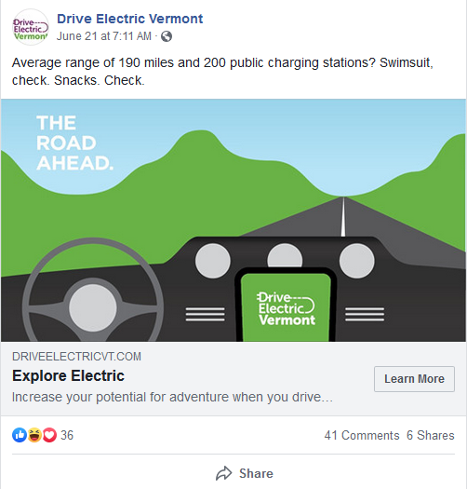
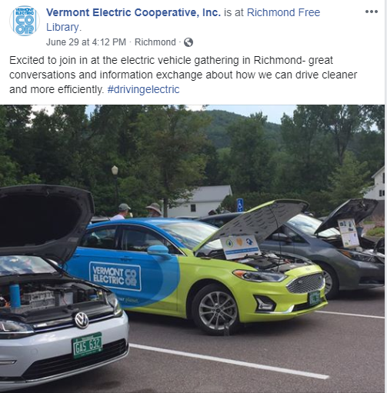
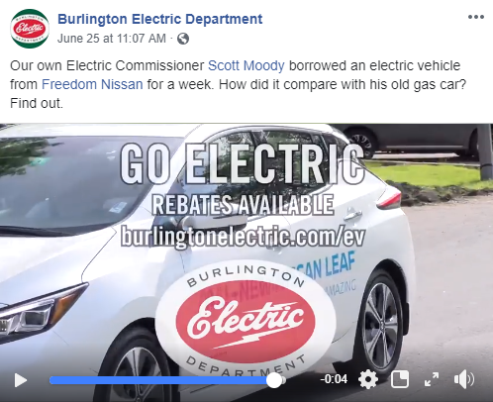
Consumer Education & Outreach
Notes:
DEV marketing campaigns – Website, search/social media ads, traffic up 38% compared to last year
Utilities
Local energy committees
Media – e.g. WCAX and VT Digger coverage of PUC EV investigation report

Slide 34
Dealer Engagement
Dealers are critical partners
“Mid-stream” programs addressing dealer barriers and motivations can be integrated with incentives
Dealers can assist consumers with incentives, including potential point-of-sale programs
Need for more EV expertise among salespersons
Reward excellence
Dealers can only sell what automakers provide. Need more crossover / all-wheel drive models to meet current customer preferences
Notes:
A mid-stream “spiff” incentive to salespersons selling EVs and/or the dealership has been used in VT and NY based pilots, in CT and other regions. Can provide a bigger bang for the buck than a consumer incentive under the right conditions.
Sales staff need more training and personal experience with EVs to be comfortable and accurate in discussing with customers.

Slide 35
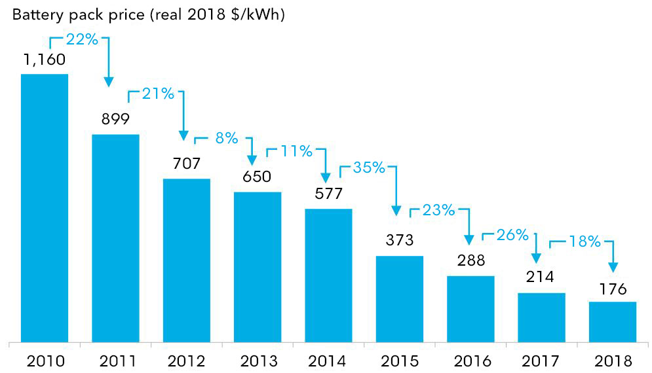
Technology – Battery Pricing
Lithium Ion battery prices have decreased 70% over last 5 years
BloombergNEF
Notes:
https://about.bnef.com/blog/behind-scenes-take-lithium-ion-battery-prices/

Slide 36
Technology – Battery Lifecycle
US Department of Energy Lithium-Ion Battery Recycling Prize
Identifying innovative solutions for collecting, sorting, storing, and transporting spent and discarded lithium-ion batteries
From electric vehicle (EV), consumer electronics, industrial, and stationary applications — for eventual recycling and materials recovery.
US DOE
Notes:
Including battery manufacturing, vehicle use, and disposal the Union of Concerned Scientists estimates 50% GHG savings compared to gasoline
https://www.ucsusa.org/clean-vehicles/electric-vehicles/life-cycle-ev-emissions
Typically 8yr/100k mile battery warranties – not many EVs have surpassed this mark yet
Starting to see servicing/replacement of cells within packs Batteries can have second lives once their ability to hold a charge decreases enough so no longer useful in vehicle
Eventually will need to be recycled. Tesla has opened a facility at their factory in Nevada, US DOE funding challenge to find more efficient/innovative ways of dealing with batteries
https://americanmadechallenges.org/batteryrecycling/

Slide 37
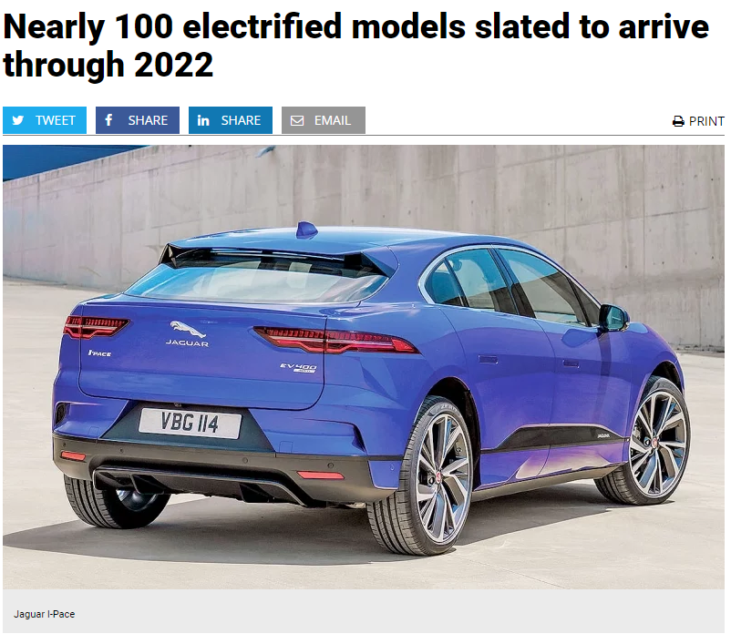
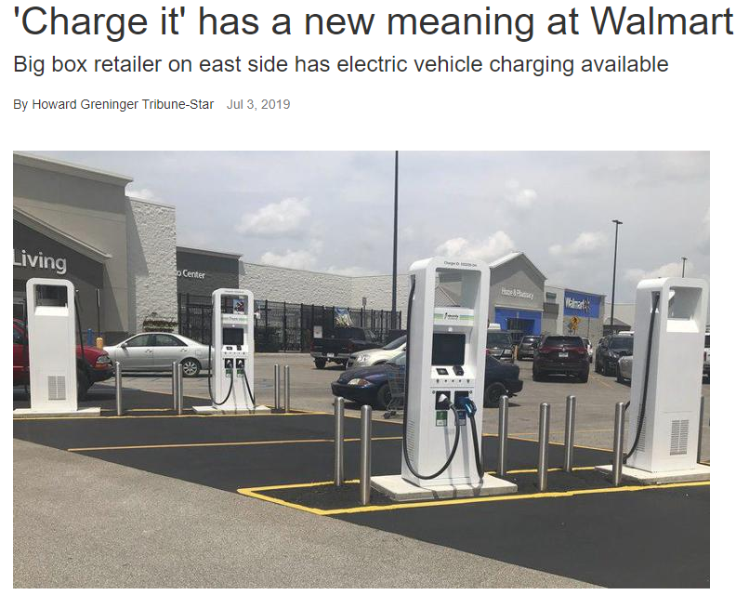
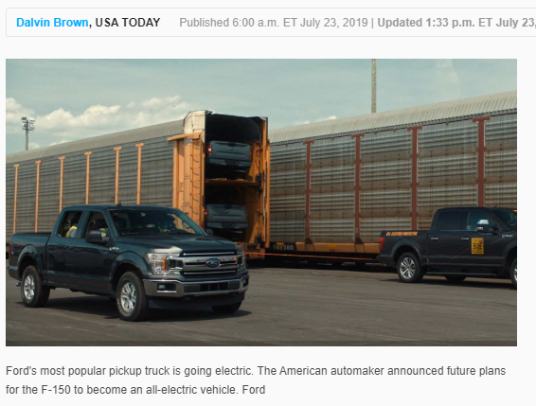
Technology Advancements
More models, more range, lower prices, faster charging, automated
Ford F-150 EV pickup prototype tows more than 1 million pounds
Notes:
New models coming
More range at lower price
Faster charging – up to 20 miles of range per minute (60 times faster than standard “level 2” options
Automation
Federal policy uncertainty makes state action more critical (e.g. potential CAFE/ZEV roll-backs)

Slide 38
Charging Infrastructure
2025 need based on 50,000 EVs in Vermont
US DOE EVI-Pro-Lite
Notes:
Number of charging ports are presented here, so in some urban or high traffic locations there may be several ports available
2025 estimates based on 50k EVs using US Dept of Energy planning tool – EVI-Pro Lite
https://afdc.energy.gov/evi-pro-lite
Mix of Plug-in Hybrid and All-Electric at default splits for different ranges
Most of the 57 existing DCFC ports are Tesla only
Also need 1,400 workplace level 2 charging plugs
State investing $2 million - maximum of VW diesel mitigation funds in EV charging; will not be enough to fill the need
From the DOE resource:
Build DC Fast First: Establishing fast charging networks that enable long-distance travel, serve as charging safety nets, and provide charging for drivers without home charging is critical to support all-electric vehicles that have no other alternative for quickly extending their driving range.

Slide 39
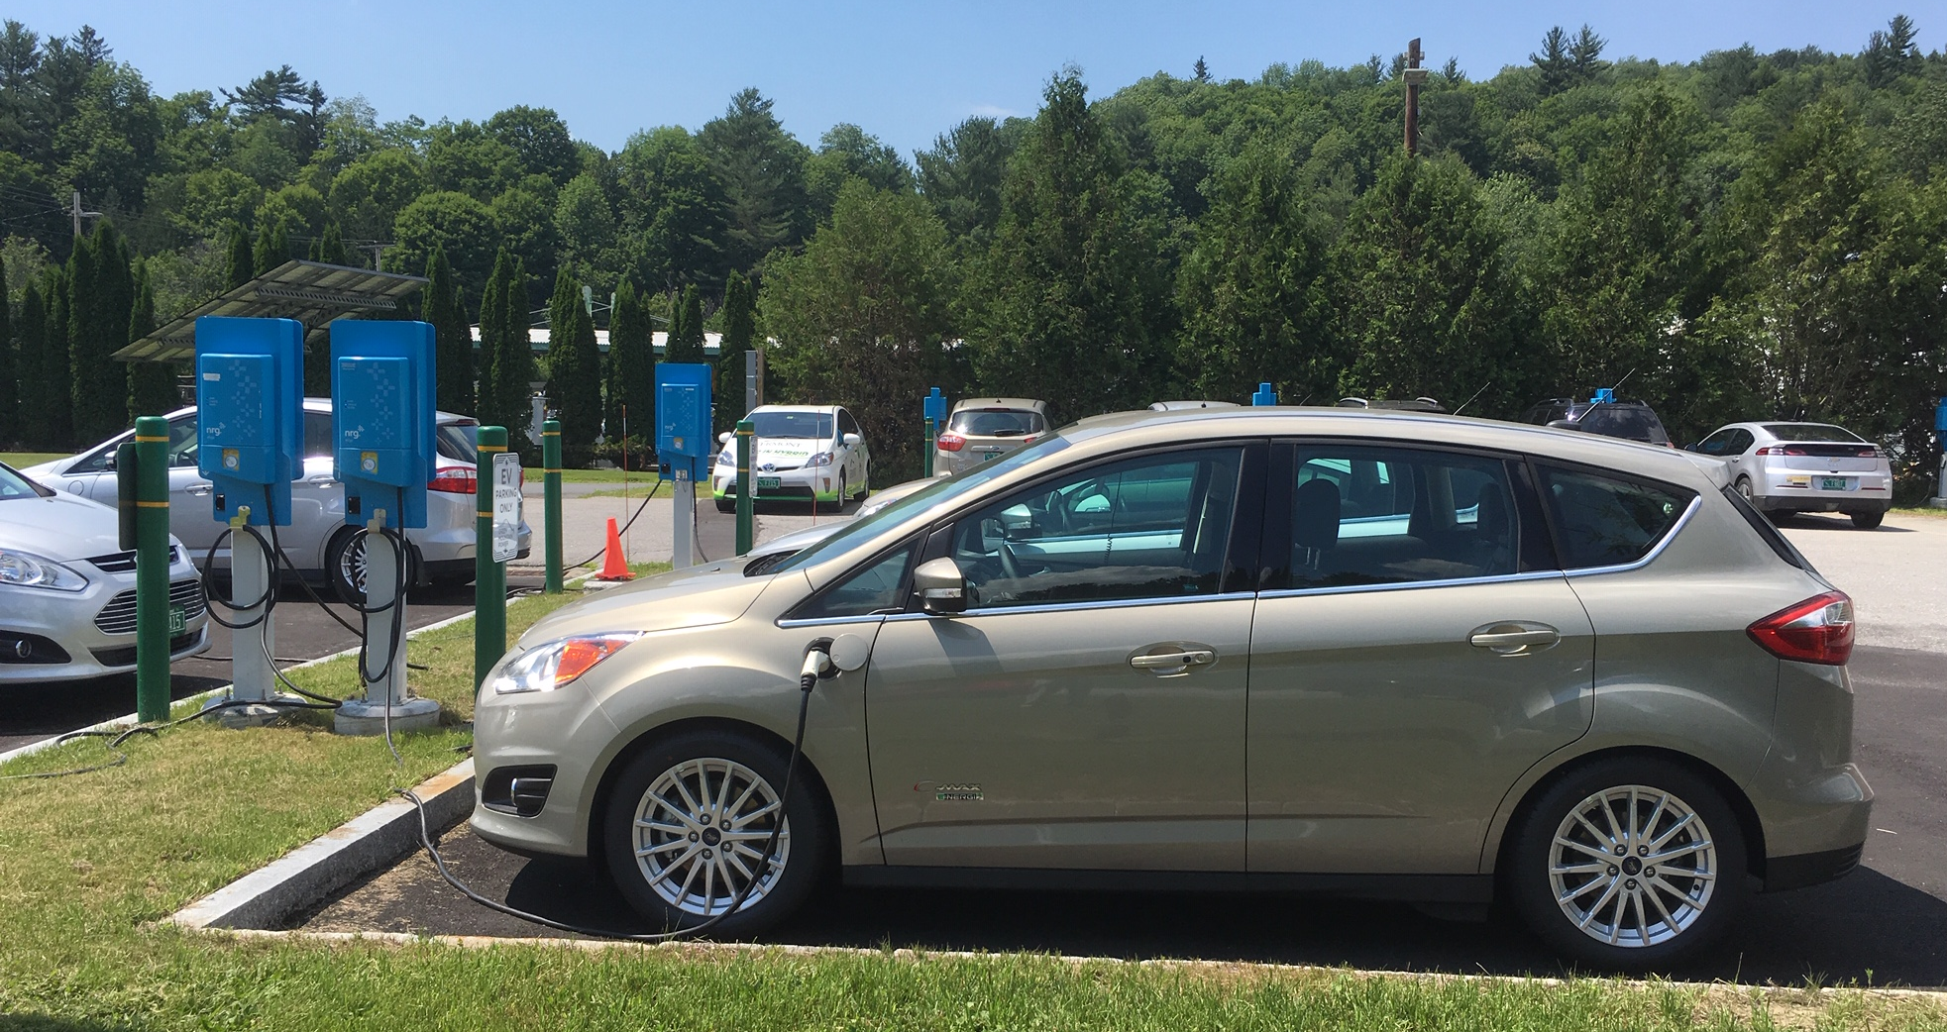
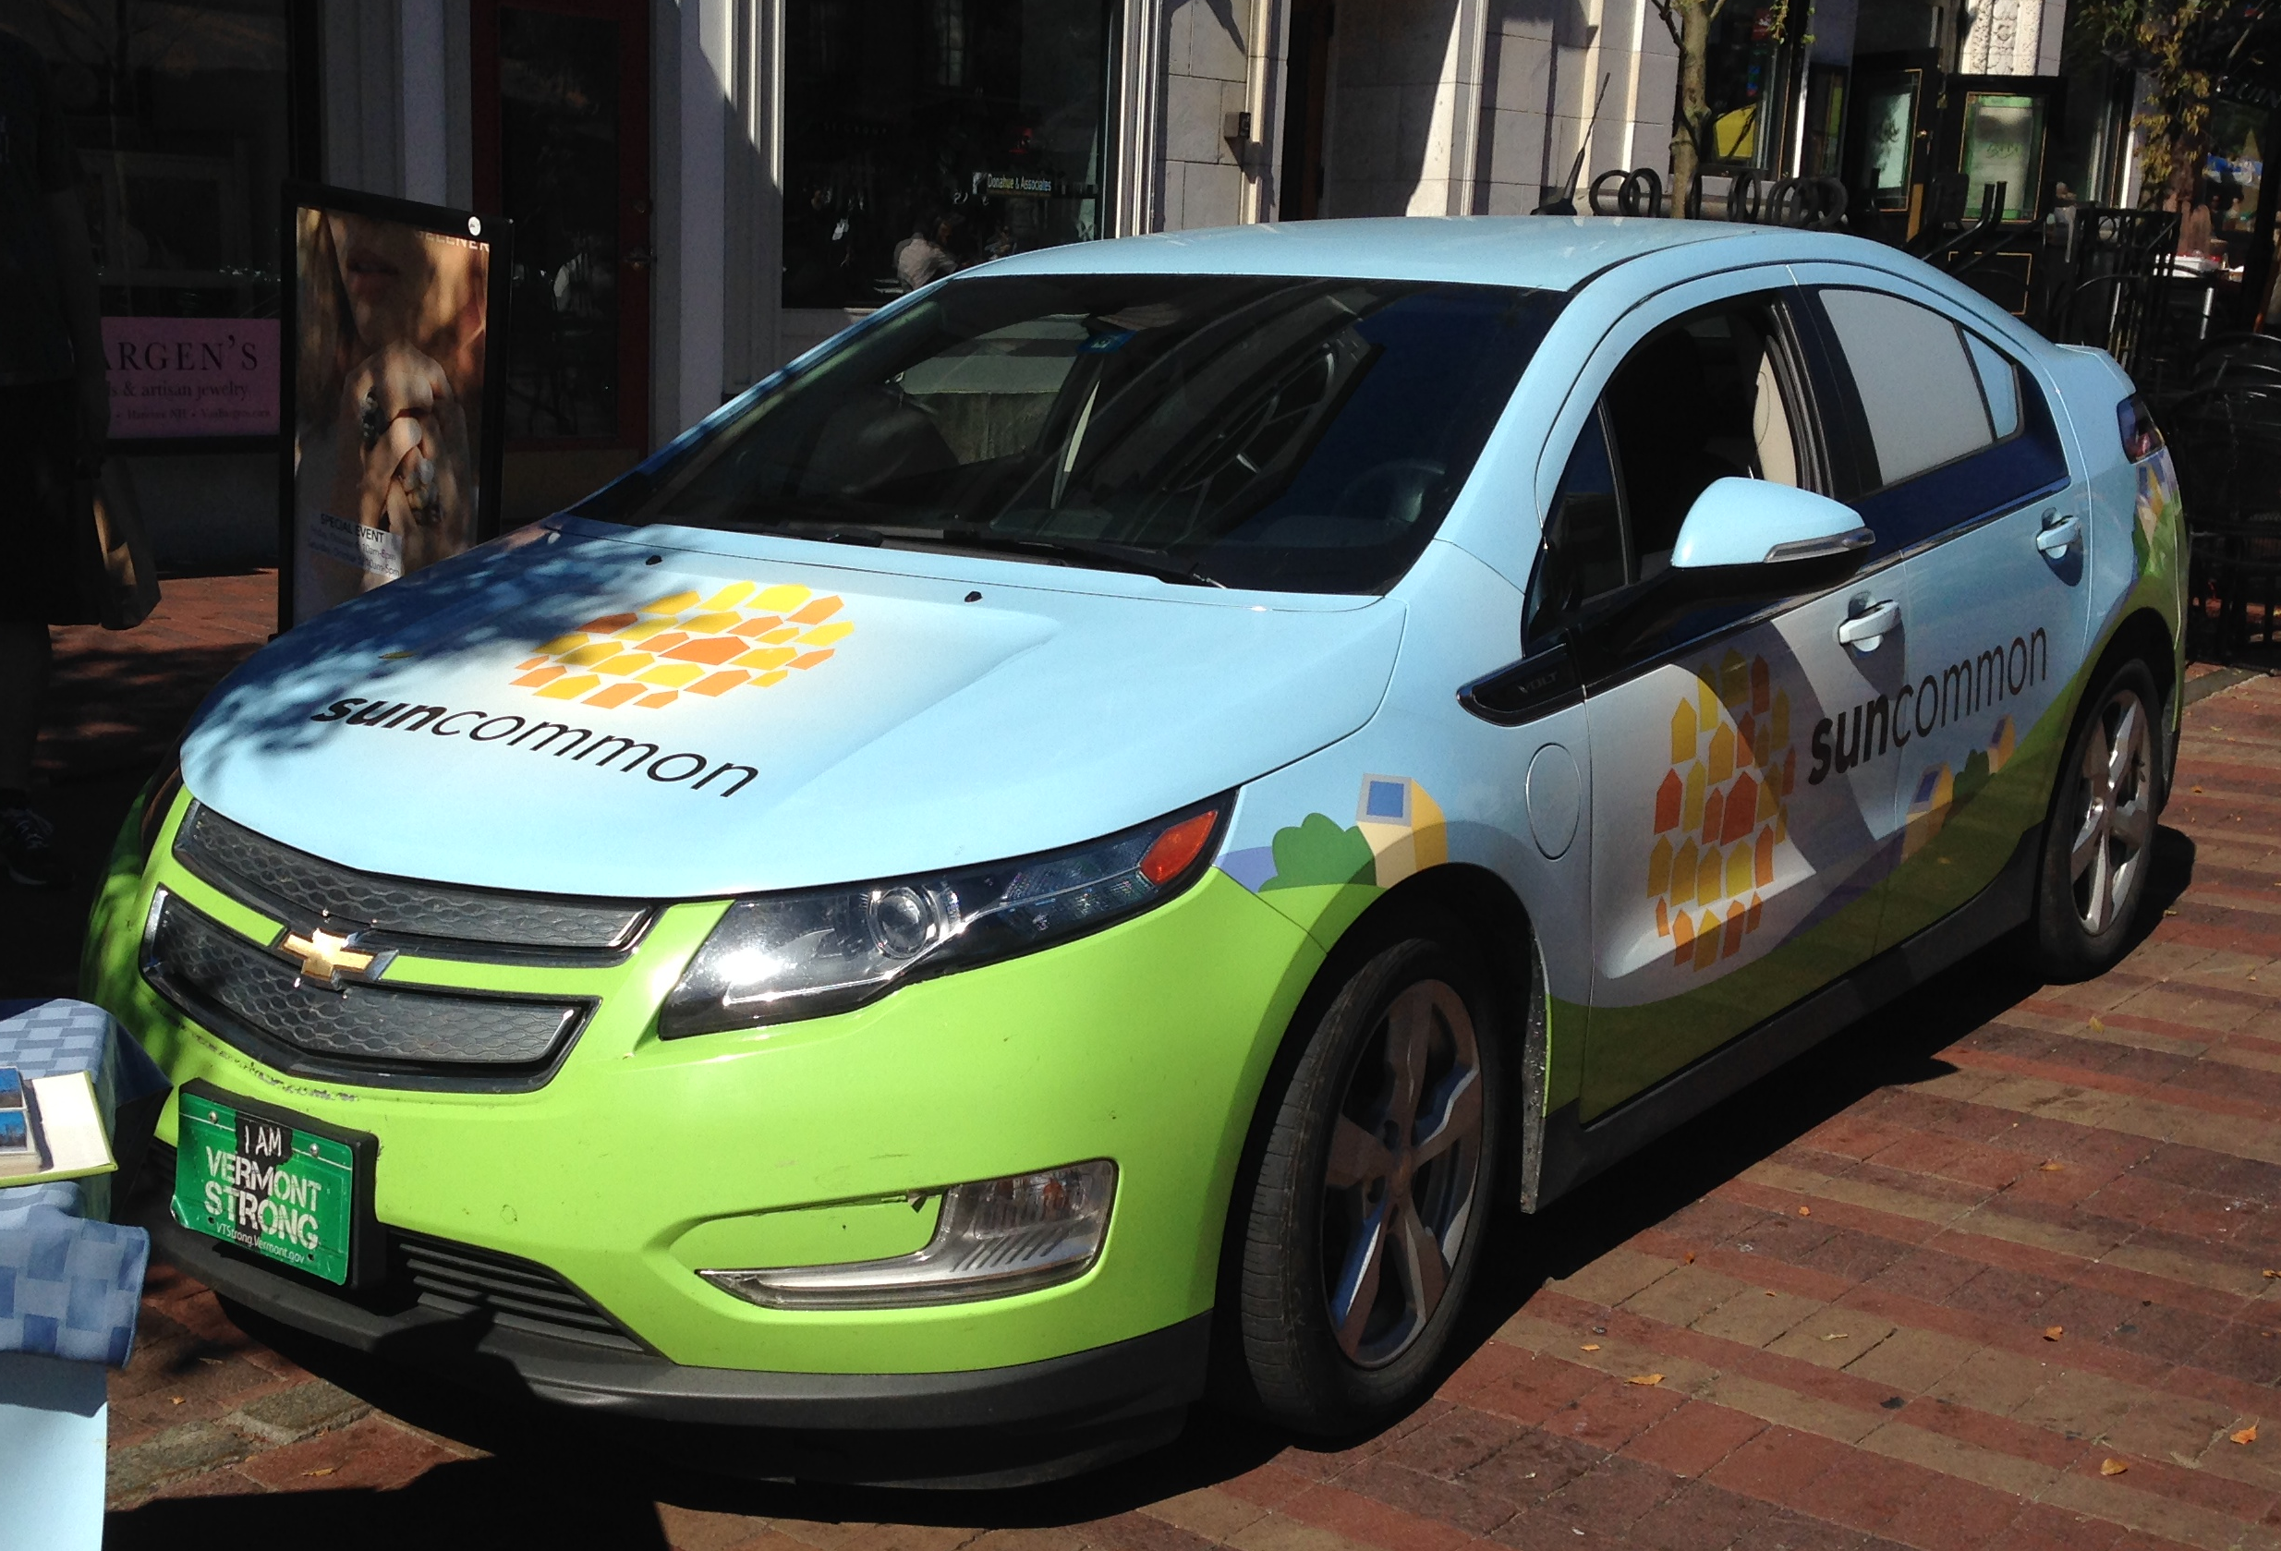
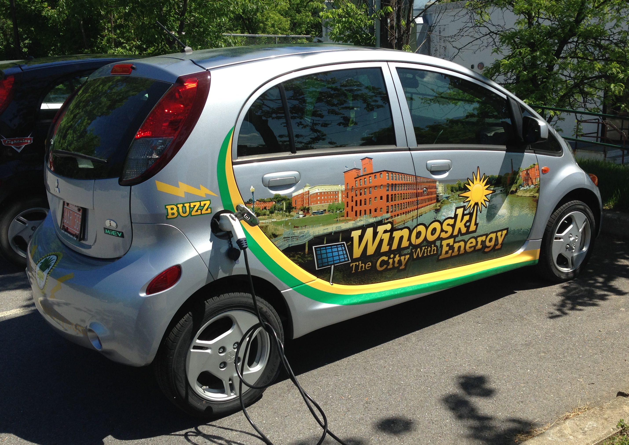
EV Fleets
State of Vermont
SunCommon
VT State Parks Knight Point
Winooski
Notes:
Fleets are ideal applications for EVs – maximize savings
NYC is integrating EVs into their fleets and so far has found their LEAFs have a total cost of ownership 21% lower than comparable gasoline car. Expect this to continue over their planned 9 years of ownership.
NYC maintenance alone savings are tracking at 79% compared to gasoline
VT Clean Cities Coalition is a resource for fleets. Planning an EV fleet conference in the Upper Valley (in conjunction with NH partners) in September. https://vtccc.w3.uvm.edu/calendar/bi-state-electric-vehicle-connector/
https://qz.com/1571956/new-york-city-says-electric-cars-cheapest-option-for-its-fleet/
https://www1.nyc.gov/assets/dcas/downloads/pdf/fleet/NYC-Fleet-Newsletter-255-March-8-2019-Reducing-Maintenance-Costs-With-Electric-Vehicles.pdf

Slide 40
Learning from Others
It took 5 years to sell the first million EVs
In 2018, it only took 6 months…

Slide 41
Global EV Overview - Sales
2018 EV Snapshot
Sales = 2.1 million EVs
China = 1.25 million (56%)
US = 361,000 (16.8%)
California = 153,000 (7.3%)
Norway = 73,000 (3.5%)
Growth = 64% over 2017
Canada = 125% over 2017
US = 79% over 2017
China = 78% over 2017
Share of New Cars Sold
Norway = 49%
British Columbia = 15.4%
California = 10%
China = 4.3%
US = 2.1%
Global EV/PHEV Sales
Notes:
http://www.ev-volumes.com/news/global-ev-sales-for-2018/
69% of sales were all-electric (BEV) and 31% were plug-in hybrids (PHEV)
All-electric vehicles have gained 3% share in the mix since 2017, driven by growth in China, the arrival of the Tesla Model-3 and losses for PHEVs in Europe when the new fuel economy test procedure WLTP became effective in September.
Source:
Canada growth - Electric mobility canada https://workandclimatechangereport.org/2019/01/28/electric-vehicle-policy-in-canada-stalled-by-provincial-opposition/
Canada growth https://www.fleetcarma.com/electric-vehicles-sales-update-q3-2018-canada/

Slide 42
Global Overview - Ownership
2018 Ownership
Total EV Stock Worldwide
<400,000 in 2013
>5.4 million as of March 2019
> 600,000 med/heavy commercial
China = 2.6 million
US = 1.1 million
Ownership per 1,000 people
Norway = 55.9
California = 13.2
Netherlands = 8.4
Sweden = 7.8
US = 3.4
China = 1.6
Notes:
http://www.ev-volumes.com/news/global-ev-sales-for-2018/

Slide 43
Case Studies

Slide 44
Norway – World’s EV Capital
Norway: undisputed leader in EV adoption
Results to date (2018)
Highest EV share of new car sales in the world (49%) US at 2.1%, VT ~3%
15.4% of registered cars US at <2%, VT 0.6%
55.9 EVs per 1000 people US at 3.4, VT 4.8
Total EVs = 230,000 (May 2018)
Lowest emissions of new passenger cars in Europe
Notes:
https://elbil.no/english/norwegian-ev-policy/
Notes
Reduced GHGs, air pollution and noise
Largest European stock of plug-in cars and vans 4th largest in the world
Norway is largest oil producer in Western Europe, one of world’s largest exporters of natural
Population 5.3 million (half the size of LA County)
One of lowest population densities in Europe
98% of electricity is carbon free (Hydro)
Electricity is relatively cheap (15 EUR/kwh in 2016 compared to Germany at 39EUR/kwh), fossil fuels price among highest in Europe
Transportation is largest GHG contributor (26.3% in 2015)
Total number of vehicles = 2.5 million
2018 top selling passenger car overall was the LEAF
15.4% of total registered vehicles are plug-ins
total number of passenger cars sold in Norway in 2018 fell to about 148,000, from a near all-time high in 2017 of 159,000. The decline showed up in sales of plug-in hybrids, hybrids, and gasoline-powered cars. Sales of all-electric cars, however, made a leap—growing by 40%.

Slide 45
Norway – Policy Goals
How did Norway do it?... First, set ambitious requirements with funding
By 2020 - 50,000 ZEVs on Norwegian roads (surpassed in Dec. 2017)
By 2025 – 100% new vehicle sales must be ZEV – including cars, urban buses and light commercial vehicles
By 2030 - all heavy-duty vans, 75% of new long-distance buses, and 50% of new trucks must be ZEV
Turning Point - Norway EV sales reached 58% of total sales (March 2019)
100% by 2025
- ELECTRIC
- FOSSIL FUEL
0%
by 2025
Notes:
Note: Norwegian policies on EVs started in the late 1990s
GHG Reduction goal = 95% by 2050 compared to 1990
Funding from:
Carbon Tax (since 1991) on petroleum production - sovereign wealth fund derived from north sea oil
Car Tax on high emissions cars (2007)

Slide 46
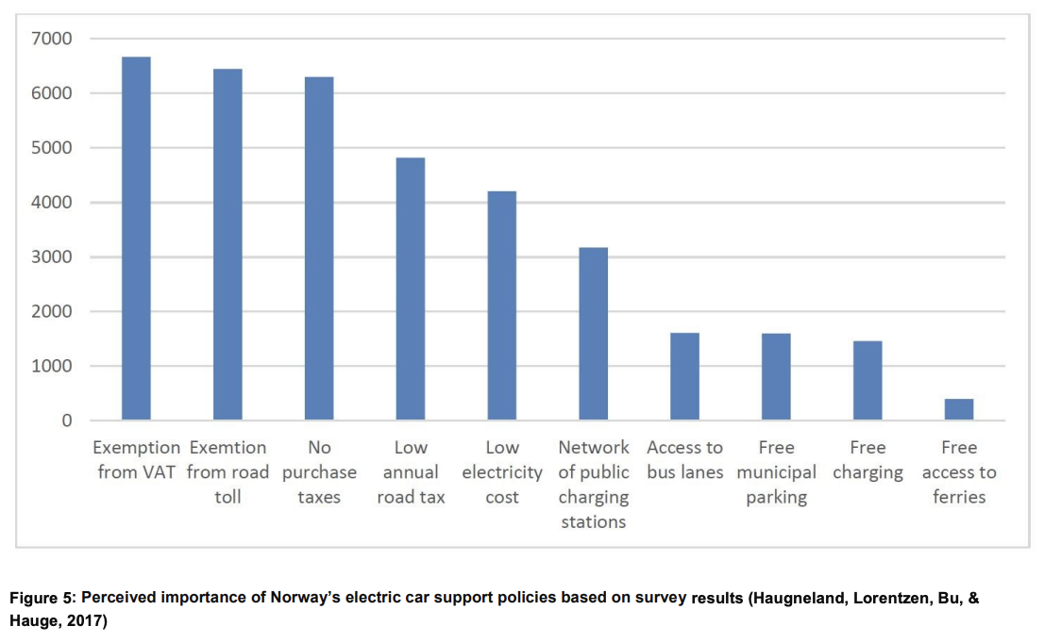
Norway - Policies
Second, adopt comprehensive policies
No purchase taxes
Reduce other fees (e.g. registration, parking, etc.)
Expand public charging infrastructure rapidly
Incentive to scrap fossil fuel vehicles if converting to EV
“Polluter Pays” Principle
Carbon Tax (1991) on petroleum production
Car Tax: High taxes for high emissions cars (2007)
BOTTOM LINE FOR POLICY
Low emissions cars should always be less expensive than high emissions cars
Notes:
https://elbil.no/english/norwegian-ev-policy/
The purchase tax for all new cars is calculated by a combination of weight, CO2, and NOx emissions. The tax is progressive, making big cars with high emissions very expensive. For the last years, the purchase tax has been adjusted gradually to have more emphasis on emissions and less on weight.
Point of Sale - Tax Exemptions
Exempt all sales/import taxes and registration fees (new & used EVs)
Discount sales tax and registration fees for all PHEVs
Annual tax rebate
Reduce other fees
No road tolls or ferry fees for all EVs (Since 2017 = max. of 50% charge)
Free municipal/public parking (since 2017 = max of 50% charge)
Free charging
Low electricity cost compared to gas
Other non-monetary
Allow access to bus and HOV lanes
Provide preferential parking spaces
EV License plates (for perk identification)
Expand Public Charging Infrastructure Rapidly
2 fast chargers every 30 miles,
Now have >10,000 publicly available chargers (pay 3x for fast charging)
Compensate scrapping fossil fuel vehicles if converting to ZEV (2018)
“Polluter Pays” Principle
Carbon Tax (1991) on petroleum production
Car Tax: High taxes for high emissions cars (2007)

Slide 47
California Example – Targeted Policies
CA – Additional focus on targeted incentives
New since 2016, Clean Vehicle Assistance Program
Income caps
Increased rebates for lower income consumers
Over 14% of the incentive funds have been issued to lower income consumers
Income Criteria
SOURCE: California Clean Vehicle Rebate Program Fact Sheet Nov 2018

Slide 48
Canada-wide Policies
New 2019 National Strategy for ZEVs
Increase Zero Emissions Vehicles to 100% of new cars sold by 2040 (10% by 2025, 30% by 2030)
1
Federal EV Purchase and Lease Incentives - CA$5,000 off new EV/PHEV less than $45,000 (or $55,000 for 7+ seats) on top of provincial incentives
Business Tax Write-off – 100% for ZEVs to support business adoption (Includes light, medium and heavy duty vehicles)
Funding for Charging Infrastructure ($120M additional). Complements existing EV Infrastructure Deployment Initiative (2016-2022) supporting coast to coast Fast Charging Network
Federal Carbon Price ($10-$50/ton from 2018-2022).
2
3
4
Notes:
Canada federal EV purchase / lease incentives launched in May 2019
https://www.tc.gc.ca/en/services/road/innovative-technologies/list-eligible-vehicles-under-izev-program.html
Charging Infrastructure eligibility:
Multi Unit Residential Buildings
Workplaces (primarily for employees)
Public parking (privately or publicly owned)
Municipal on-street parking
Dedicated Corporate fleets (owned or leased to support operations)
Delivery fleets (freight, including last mile shipping)
Mass transit (inner-city buses)
Sources:
https://www.tc.gc.ca/en/services/road/innovative-technologies/zero-emission-vehicles.html
https://www.canada.ca/en/transport-canada/news/2019/04/government-of-canada-invests-in-zero-emission-vehicles.html

Slide 49
QUEBEC
POLICIES
Drive Green Program (2011)
Rebates now stacked onto federal incentives
up to CA$13,000 for new EVs
Used Vehicle Pilot – up to CA$4,000 for all-electric used vehicles
Green Taxi incentives
CA$20,000 for EVs, CA$12,000 for PHEVs, 75% of charging station
Charging station incentives – Goal of 5,000 (2013)
Up to CA$600 per home station; Up to CA$5,000 per multi-unit residential
Government Fleet Electrification
Replace all with EV or PHEV by 2017 (total 2000)
ZEV requirement for automakers
first province to adopt (3.5% cars sold 2016 to 15.5% in 2020)
HOV lane access
Cap and Invest Program (WCI) since 2014 to generate revenue and reduce fossil fuel use (in addition to federal carbon tax)
Leader in overall adoption
Total = >31,500
Market Share = 3.3%
2018 Sales >12,000
Growth = 131% over 2017
Share of new car sales = 9.8%
Notes:
Rebates now stacked onto federal incentives (since 2012)
up to CA$ 8,000 (starting 2012) for new EVs
Up to CA$1,000 for PHEVs
Used Vehicle Pilot – up to CA$4000 for all electric used vehicle
Govt earmarked $50m in 2012, then $65m in 2013
Green Taxi incentives
CA$20,000 for EVs, CA$12,000 for PHEVs
Pay 75% of cost of 125 charging stations (up to CA$5000)
Charging station incentives – Goal of 5,000 (2013)
Up to CA$600 per home station installation; Up to CA$5,000 per multi-unit residential station
500 around cities and “electric circuit” route
1000 near Govt buildings
3,500 at workplaces for employee use (75% rebate for businesses up to CA$5000 Level 1 or 2
Government Fleet Electrification
Replace all with EV or PHEV by 2017 (total 2000)
ZEV requirement for automakers (first province to adopt in 2016, in effect 2018)
3.5% cars sold (2016) to 15.5% in 2020
Tradeable credit system
HOV lane access
Cap and Invest Program (WCI) since 2014 to Generate Revenue (in addition to federal carbon tax)
Sources:
https://sfustart.files.wordpress.com/2016/11/canadas-electric-vehicle-policy-report-card.pdf
https://www.tc.gc.ca/en/services/road/innovative-technologies/zero-emission-vehicles.html
https://www.canada.ca/en/transport-canada/news/2019/04/government-of-canada-invests-in-zero-emission-vehicles.html
https://www.fleetcarma.com/electric-vehicles-sales-update-q3-2018-canada/

Slide 50
Lessons from Canada
Best Demand-Focused Policies
1
Financial Incentives (e.g. subsidies, rebates, waived fees, tax exemptions)
5
Building Regulations (e.g. Codes or by-laws mandating a certain level of charging access)
2
Non-Financial Incentives (e.g. designated parking, HOV access)
6
Information Campaigns (e.g. Public sponsored ads, websites, vehicle labeling)
3
Public Charging Deployment (especially fast charging, free parking/charging)
7
Government Investment in Public Fleets (e.g. govt and municipal fleets, transit and school buses)
4
Carbon Pricing making low-carbon electricity cheaper than gas (e.g., Cap-and-Invest, Carbon Tax)
8
Planning efforts and support (e.g. support to businesses, local governments, and schools)
SOURCE: Sustainable Transportation Action Research Team. Simon Fraser University.
Notes:
Notes:
Financial Incentives reduce the cost of EVs and Charging infrastructure. The most common types are subsidies, rebates, waived user fees, and tax exemptions
Non-financial incentives offer other benefits to consumers including unrestricted access to lanes reserved for HOV and free parking/charging
Public charging deployment provides access to charging away from home. Many regional governments and utilities have invested in the deployment of public chargers and some also offer free charging.
Carbon Pricing increases the price of fuels and activities that generate carbon emissions and makes low-carbon electricity even cheaper than gasoline. For example, gas prices would increase roughly 7 cents per litre with a carbon price of $30/tonne. The two main types of carbon pricing policies are carbon taxes and cap-and-invest programs
Building regulations can make the installation of home charging cheaper and easier. This can include building codes or by-laws which mandate a certain level of charging access in new buildings. Regulations can also require the installation of circuits to support EV charging, or result in “right-to- charge” bylaws that empower individuals to set up charging infrastructure in apartments, condos, and townhomes.
Information campaigns educate the public about EVs and charging and include public sponsored advertising, consumer outreach, informational websites, and vehicle labeling.
Other demand focused policies include government investment in EVs for public fleets and planning efforts related to EVs.
Sources:
https://sfustart.files.wordpress.com/2016/11/canadas-electric-vehicle-policy-report-card.pdf
https://www.tc.gc.ca/en/services/road/innovative-technologies/zero-emission-vehicles.html
https://www.canada.ca/en/transport-canada/news/2019/04/government-of-canada-invests-in-zero-emission-vehicles.html

Slide 51
Lessons from Canada
Best Supply-Focused Policies
1
Zero Emission Vehicle (ZEV) requires auto manufacturers to sell a minimum % of EVs
4
Vehicle Emissions Standards require maximum level of tailpipe emissions for each vehicle class.
2
Research and Development support (e.g., public funding for innovation and development)
5
Support for Local Industry Development related to electric vehicle development (including electric bikes, motorcycles, boats, etc.)
3
Low Carbon Fuel Standards require fuel suppliers to reduce carbon intensity of the fuels they sell (met by purchasing credits from utilities, creating an incentive for utilities to support EV deployment)
SOURCE: Sustainable Transportation Action Research Team. Simon Fraser University.
Notes:
Zero Emission Vehicle (ZEV) mandates require auto manufacturers to sell a minimum % of electric or hydrogen fuel cell vehicles, encouraging automakers to research, develop, and market a wider variety of models, and potentially lower sales prices as well
Research and Development support provides government funding for technology innovation and development related to EVs (e.g. development of batteries, electric drivetrain innovation, or electric vehicle demonstrations)
Low Carbon Fuel Standards require fuel suppliers to reduce carbon intensity of the fuels they sell in a regulated region. A fuel supplier can meet requirements by purchasing credits from electric utilities that supply electricity to EVs, creating an incentive for utilities to support EV deployment (to build more chargers or lower electricity rates for EV users)
Vehicle Emissions Standards specify a required maximum level of tailpipe emissions for each vehicle class. Because EVs produce zero tailpipe emissions, their sale can help automakers comply.
Support for Local Industry Development related to electric vehicle development (including electric bikes, motorcycles,
Sources:
https://sfustart.files.wordpress.com/2016/11/canadas-electric-vehicle-policy-report-card.pdf
https://www.tc.gc.ca/en/services/road/innovative-technologies/zero-emission-vehicles.html
https://www.canada.ca/en/transport-canada/news/2019/04/government-of-canada-invests-in-zero-emission-vehicles.html

Slide 52
Global Overview – Policy Insights
Most effective policies
4
Expand Equity and Access
Rebates for low income drivers
Electric Car-sharing Programs
Charging Access for Underserved Communities, Multi-Unit Dwellings
Charging at Places of Employment
Expand Access to Electric Public Transport
Vehicle Registration Fees
Waive or Reduce Registration Fees for EV Drivers
Resist Anti-EV Registration Fees
Promote Consumer Education & Protection
EV Proclamations and Driver Bill of Rights
Ride and Drive Events
Open Access and Interoperability
Uniform Signage Requirements
Target CO2 Content & Raise Revenue
Cap & Invest, Carbon Tax, High Emissions Vehicle Tax
Apply technology-neutral regulations on tailpipe CO2 emissions
ZEV requirement for Automakers
1
Expand Incentives
Vehicle rebates and tax credits
Sales Tax Exemptions
HOV Access, Free Parking/Charging, Toll Exemptions
Scrapping incentives
Electrify Vehicle Fleets
Government/Municipal Fleet Mandates
Transit Bus/School Bus Fleet Mandates
Use VW Settlement Funds for ZEV Adoption Only
Expand Charging Access
EV-Ready Wiring Codes and Ordinances
Multi-Unit Dwellings
Streetlight and Power Pole Charging Access
Right of Way Charging
EV-Utility Investments
Use VW Settlement Funds to Grow EV Charge Networks
5
2
6
3
7
8
Source: Global EV Outlook 2018. OECD/IEA.
AchiEVe: Model State & Local Policies to Accelerate EV Adoption. Sierra Club and Plug-In America. June 2018.
Notes:
"Right to charge" legislation/ordinances so MUD dwellers can't be denied the right to plug-in. Rebates for low-income need to be point of sale.

Slide 53
What’s Next?

Slide 54
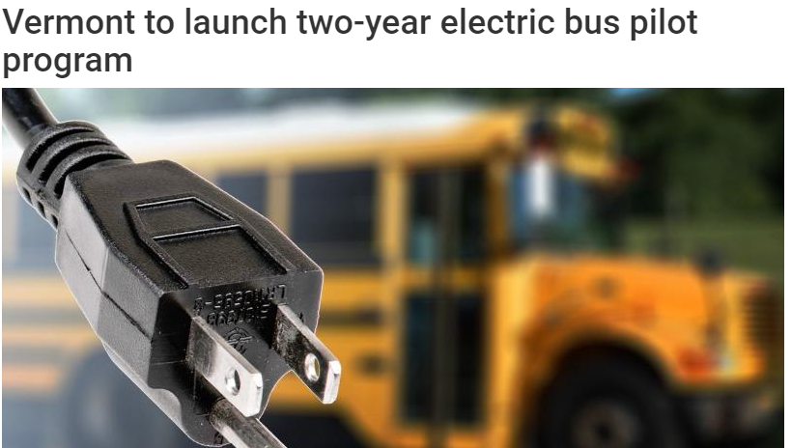
Heavy Duty Vehicle Programs
Fewer options currently available for heavy duty electrification
Electric transit buses are the most advanced in this area
School buses, refuse trucks, and other options coming along
Several states have heavy duty EV programs
California and New York have led other states
VW diesel mitigation funding advancing this market segment
Vermont has launched a 2-year electric transit and school bus pilot program
Notes:
Also options available in off-road applications
many utilities offering incentives for commercial electric mowers and some for home use too
Farm equipment in development, some tractor conversions already out there
Hydrogen, biofuels also possibilities in this sector

Slide 55
Additional Resource Slides

Slide 56
Global EV Overview – Policy Insights
Most effective policies
1
Vehicle purchase
Accelerate public procurement programs (buses and municipal vehicles)
Promote fiscal/financial incentives at time of vehicle purchase (tax exemption, purchase incentives, registration fee exemption)
Implement taxes that reflect CO2 content (cap and invest, carbon tax, or high-emissions-vehicle tax)
Initiate complementary measures to enhance value proposition (preferential parking rates, toll exemptions, etc.)
Apply technology-neutral regulations on tailpipe CO2 emissions
Mandate requirement that automakers to sell minimum share of ZEV
2
Charging Station Infrastructure
Rapidly expand publicly accessible stations, with focus on fast charging
Allow non-utility stakeholders to enter charging services market
Increase supply of variable renewable energy
Mandate EV-readiness for new or renovated buildings
Longer Term Issues
Foregone revenues from fuel taxation will call for alternative tax approaches
Taxation based on vehicle activity (e.g. distance-based pricing) is well-suited to maintain transportation infrastructure and to give a price to GHG pollutants based on impact on health, environment, and reduced traffic congestion
3
Source: Global EV Outlook 2018. OECD/IEA 2018
Notes:
Karen Glitman - We talk about the 3 pillars of successful incentive programs: 1. Outreach. Marketing, education, and outreach, 2. Design. Customer support and user-friendly application features, 3. Transparency. Create program and market intelligence through program transparency & evaluation that actively informs program improvement over time, and empowers stakeholders throughout the EV ecosystem to make evidence-informed decisions

Slide 57
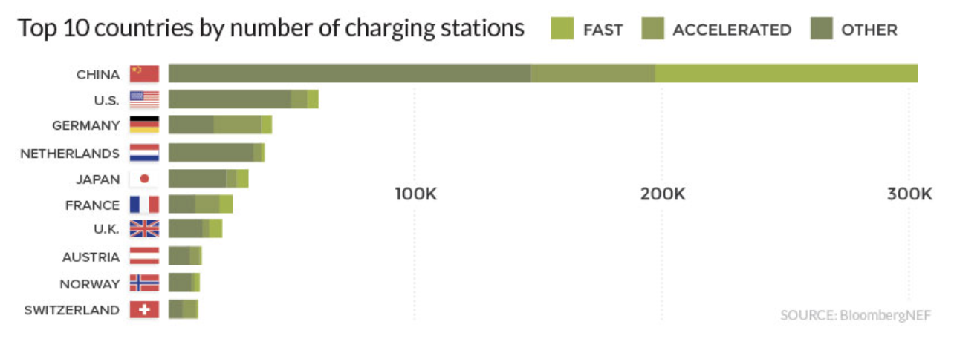
Global Overview - Charging
2018 Charging
Total Public Charging Stations
China = 330,000
Norway = 100,000
US = 67,500
Growth Rate
China = 43% over 2017
US = 33% over 2017
Share DC Fast Charging
China = 36% from 24% in 2017
US = 14% from 11% in 2017
Notes:
Sources:
EV Charging in China and the US. Feb 2019. EnergyPolicy.Columbia.edu
https://elbil.no/english/norwegian-ev-policy/
https://www.visualcapitalist.com/electric-vehicle-sales/

Slide 58
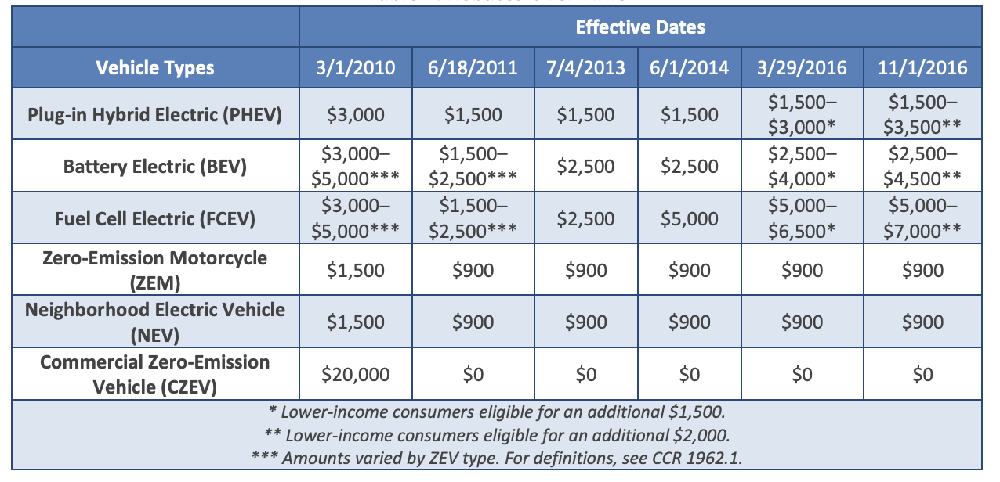
California Example – Targeted Policies
Sliding-scale EV purchase incentives
CA Clean Vehicle Rebate Project (CVRP)
Since 2010 >319,000 rebates
EVs/PHEVs account for 98% of rebates
“Lower income consumers” <300% federal income poverty level
Rebates over time
SOURCE: California Clean Vehicle Rebate Program Fact Sheet Nov 2018
Notes:
https://cleanvehiclerebate.org/eng/rebate-statistics

Slide 59
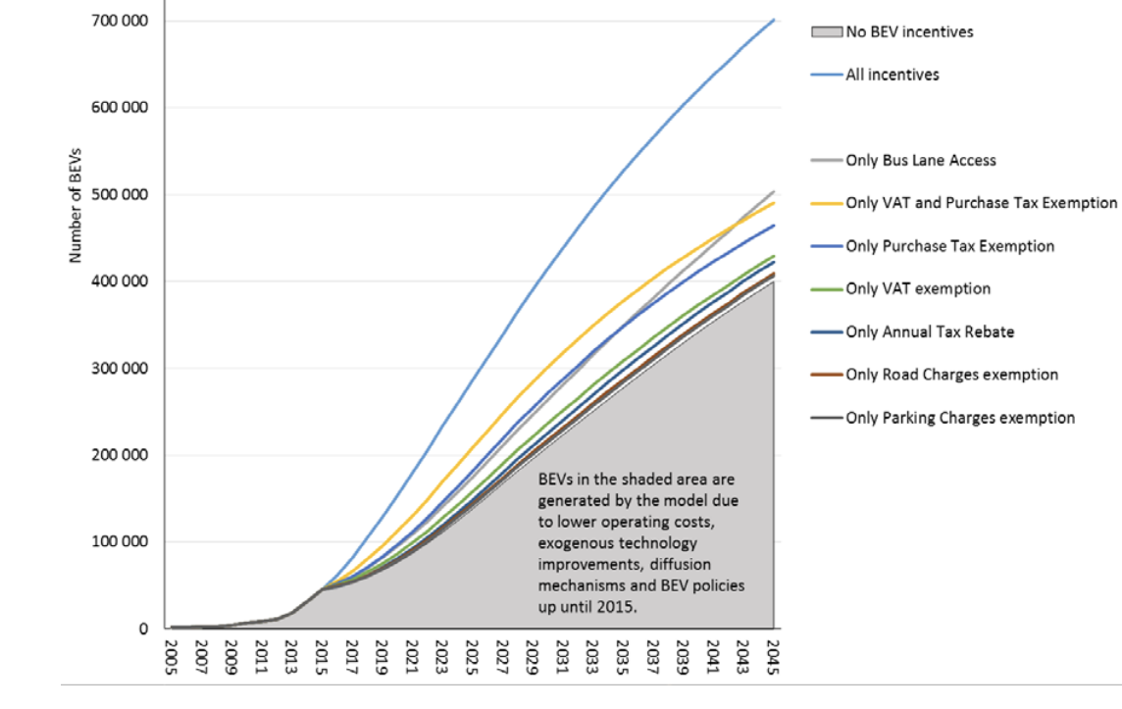
Norway – Policy Effectiveness
Most effective policies
Make EVs cheaper than comparable conventional cars to purchase
Sales/import tax exemptions
Registration fee exemptions
Scrapping fee
Make EVs cheaper to operate beyond the already favorable electric vs gas comparison
Bus Lane Access
Annual Tax rebate
Road charge exemption
Parking charge exemption
Pollution Tax on high GHG emissions vehicles
Generate sufficient revenue to cover costs
Carbon tax and high-emissions vehicle tax

Slide 60
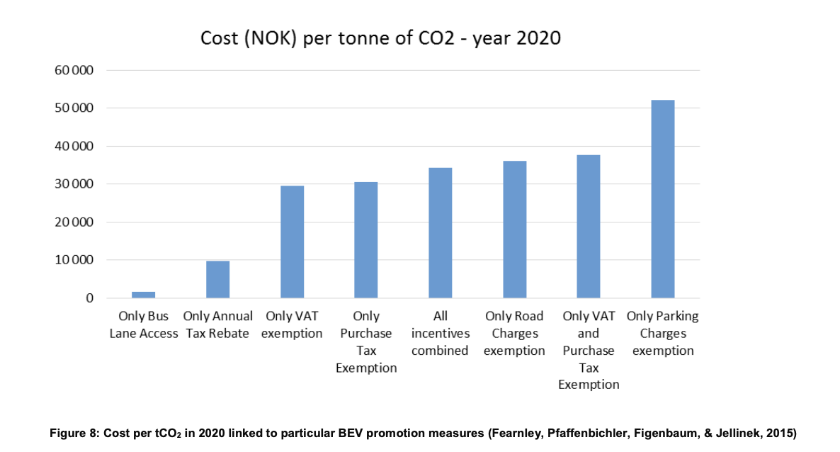
Norway – Institutions
Third, ensure supportive institutions and infrastructure
Strong legislative, administrative and utilities support
Transportation strategy with emissions targets
Guidance for policy makers on how to prioritize policy measures (e.g. tax exemptions, incentives, carbon pricing, etc)
Aggressive use of settlement funds
Electric Vehicles Association
To promote collaboration, lobbying voice, and public outreach strategies
Charging Infrastructure – State Agency
Norway’s Enova supports public charging infrastructure in municipalities as well as sustainable shipping and freight transport

Slide 61
Canada – Rapid Growth in 2018
2018 Highlights
Sales
125% increase over 2017 (79% in US)
More EVs sold in 2018 than previous 3 years combined (>35,000)
Share of new car sales
2.2% (2.1% in US)
Total EVs = >100,000
Target was 500,000 by 2018
No national plan until 2019, except 3 provinces
QC, BC, ONT had 97% of Canadian EV/PHEV sales (2013-2018)
Notes:
On the other end of the spectrum, Alberta, Manitoba, Newfoundland and Labrador, New Brunswick, Nova Scotia, and Saskatchewan, do not currently appear to have legislation or programs to encourage the adoption of ZEV or hybrid vehicles. A number of these provinces previously had rebate programs to incentivize the purchase or lease of low-emission vehicles or ZEVs, but these are no longer in place.
Plug In vs. All-Electric - PHEV growing slightly faster
Sources:
Canada – Electric Mobility Canada
Canadian Govt - https://www.nrcan.gc.ca/energy/transportation/alternative-fuels/resources/21312
https://www.fleetcarma.com/electric-vehicles-sales-update-q3-2018-canada/
https://www.nationalobserver.com/2019/01/18/news/electric-vehicle-strategy-sputters-provinces-battle-it-out-green-policies

Slide 62
Canada – Leading Provinces
Leading Provinces
(2018/through Q3)
Quebec
Sales (>12,000)
Growth = 131% over 2017
Share of new car sales = 9.8%
British Columbia
Sales (>6,000)
Growth = 151% over 2017
Share of new car sales = 15.4%
Ontario
Highest 2018 Total Sales (>15,000)
Fastest Growth (209% over 2017)
Share of new car sales = 8.2%
Notes:
https://www.fleetcarma.com/electric-vehicles-sales-update-q3-2018-canada/
Quebec – lower electric rates and higher gasoline prices

Slide 63
BRITISH COLUMBIA
POLICIES
Clean Energy Vehicle Program (2011)
Rebates now stacked onto federal incentives and SCRAP-IT incentives
Up to CA$16,000 in total incentives for a new EV
Additional Support for CEV fleets, medium/heavy-duty, and electric motorcycles
SCRAP-IT incentives to get older vehicles off the road
Up to CA$6,000 for purchase of: EV/Low emissions vehicle, transit passes, credit w/car sharing, new bike
Expand Charging Infrastructure
>1000 public stations; new emphasis on multi-unit residential and fast chargers
HOV lane access with decal
Investments in R&D, trainingTargeted support to companies in pre-commercialization, commercialization, demonstration or use of BC-based CEV product (198 companies/orgs)
and outreach
ZEV quota for auto dealers – no gas cars sold after 2040 (2018)
Low carbon fuel standard (10% reduction by 2020)
Carbon Tax since 2008 to generate revenue
$35/ton CO2e to $40/ton in 2019; will increase $5 annually til $50/ton in 2021
Leader in new car sales (15.4%)
Total = >14,900
Market share = >3.7%
2018 Sales >6,000
Growth = 151% over 2017
Share of new car sales = 15.4%
Most charging stations in Canada (over 1000)
Notes:
Low Carbon Fuel Standards require fuel suppliers to reduce carbon intensity of the fuels they sell in a regulated region. Requirements can be met by purchasing credits from utilities creating an incentive for utilities to support EV deployment
Clean Energy Vehicle Program (2011)
Point of Sale Incentives for purchase or lease of passenger CEVs
Up to CA$5,000 for a new EV (in addition to CA$5,000 federal and SCRAP-IT)
Up to CA$2,500 – $5,000 for a PHEV (in addition to CA$5,000 federal and SCRAP-IT)
Price cap CA$77,000 (CA$45,000 for federal)
Eligible recipients: Residents, Businesses, Non profits, Local government
Funded by Govt and administered by the New Car Dealers Association
Additional Support for CEV fleets, medium/heavy-duty, and electric motorcycles
Expand Charging Infrastructure
Now >1000 public stations; Feb 2019 new support for fast chargers (Federal & Province support)
Recent emphasis on multi-unit residential buildings
HOV lane access with decal
Investments in R&D, training and outreach
Targeted support to companies in pre-commercialization, commercialization, demonstration or use of BC-based CEV product (198 companies/orgs)
Outreach: http://www.emotivebc.ca/, https://pluginbc.ca/
ZEV quota for auto dealers – no gas cars to be sold after 2040 (2018)
Low carbon fuel standard (10% reduction by 2020)
SCRAP-IT incentives to get older vehicles off the road
Up to CA$6,000 for purchase of: EV/Low emissions vehicle, transit passes, credit w/car sharing, new bicycle
Funded by a non-profit organization that relies on private funding, grants and program partners
Carbon Tax since 2008 to generate revenue
$35/ton CO2e to $40/ton in 2019; will increase $5 annually til $50/ton in 2021
Sources:
https://sfustart.files.wordpress.com/2016/11/canadas-electric-vehicle-policy-report-card.pdf
https://www.tc.gc.ca/en/services/road/innovative-technologies/zero-emission-vehicles.html
https://www.canada.ca/en/transport-canada/news/2019/04/government-of-canada-invests-in-zero-emission-vehicles.html
https://www.fleetcarma.com/electric-vehicles-sales-update-q3-2018-canada/

Slide 64
ONTARIO
POLICIES
Rapid progress 2010-2018, then new Govt cancelled most policies
Highest Rebates
First Province to offer purchase incentives (2010)
Up to CA$14,000 (cancelled June 2018)
Charging station incentives (2013)
CA$1000 per station (Cancelled in June 2018)
HOV lane access
City of Toronto EV-ready building regulation
Cap and Invest Program - WCI (2017)
Cancelled in June 2018
Leader in 2018 sales growth
Total = >31,300
2018 Sales >15,000
Growth = 209% over 2017
Share of new car sales = 8.2%
Notes:
Sources:
https://sfustart.files.wordpress.com/2016/11/canadas-electric-vehicle-policy-report-card.pdf
https://www.fleetcarma.com/electric-vehicles-sales-update-q3-2018-canada/
https://www.tc.gc.ca/en/services/road/innovative-technologies/zero-emission-vehicles.html
https://www.canada.ca/en/transport-canada/news/2019/04/government-of-canada-invests-in-zero-emission-vehicles.html

Slide 65
Funny Video – best selling models
Evolution of US EV Sales (with GoT Music!)
Notes:
Karen Glitman - Our cliff notes for this. "The year of the LEAF, followed by the rise of the plug-in hybrid, Tesla finally starting to come into its own, the emergence of choice, and the blitz of the Model 3."

