Slide 1
Climate Accountability and Collective Action Problems: Assessing Per Capita Emissions Across New England
Cara Robechek, Deputy Director & Network Manager
Jared Duval, EAN Executive Director
Lena Stier, Data Manager & Research Analyst
Notes:
Cara. Welcome everyone to this webinar on climate accountability and collective action problems where we will share the findings of EAN’s latest research paper comparing per capita emissions across the New England states and placing those findings in a broader regional, global, and historical context.
Share logistics (i.e. esp. how we will do questions)
To begin, I’d like to introduce EAN.

Slide 2
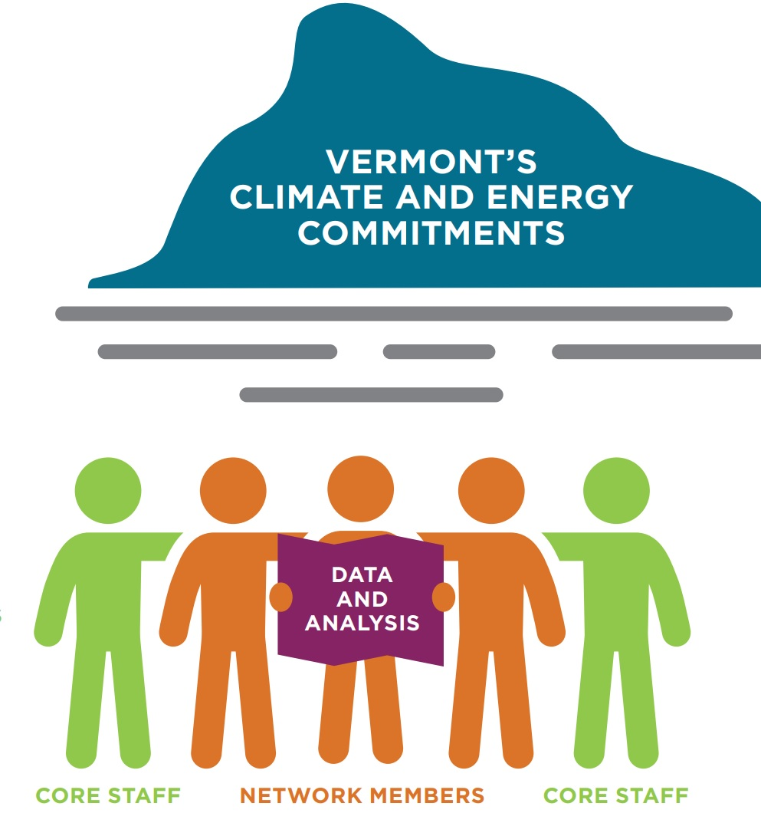
Energy Action Network (EAN)
Mission:
“To achieve Vermont’s climate and energy commitments in ways that create a more just, thriving, and sustainable future for Vermonters.”
Notes:
The mission of EAN’s network of members is to achieve Vermont’s climate and energy commitments in ways that create a more just, thriving, and sustainable future for Vermonters.”
EAN has two main roles in the state of Vermont. 1) Convene and serve as a trusted facilitator within and across the network. 2) Support our network and the State of Vermont with independent research, tracking, and analysis.

Slide 3
Notes:
Energy Action Network as a nonprofit is also backbone organization supporting a broad Network of organizations, businesses, utilities,and institutions of higher learning, a small sample of which are represented on this slide.

Slide 4
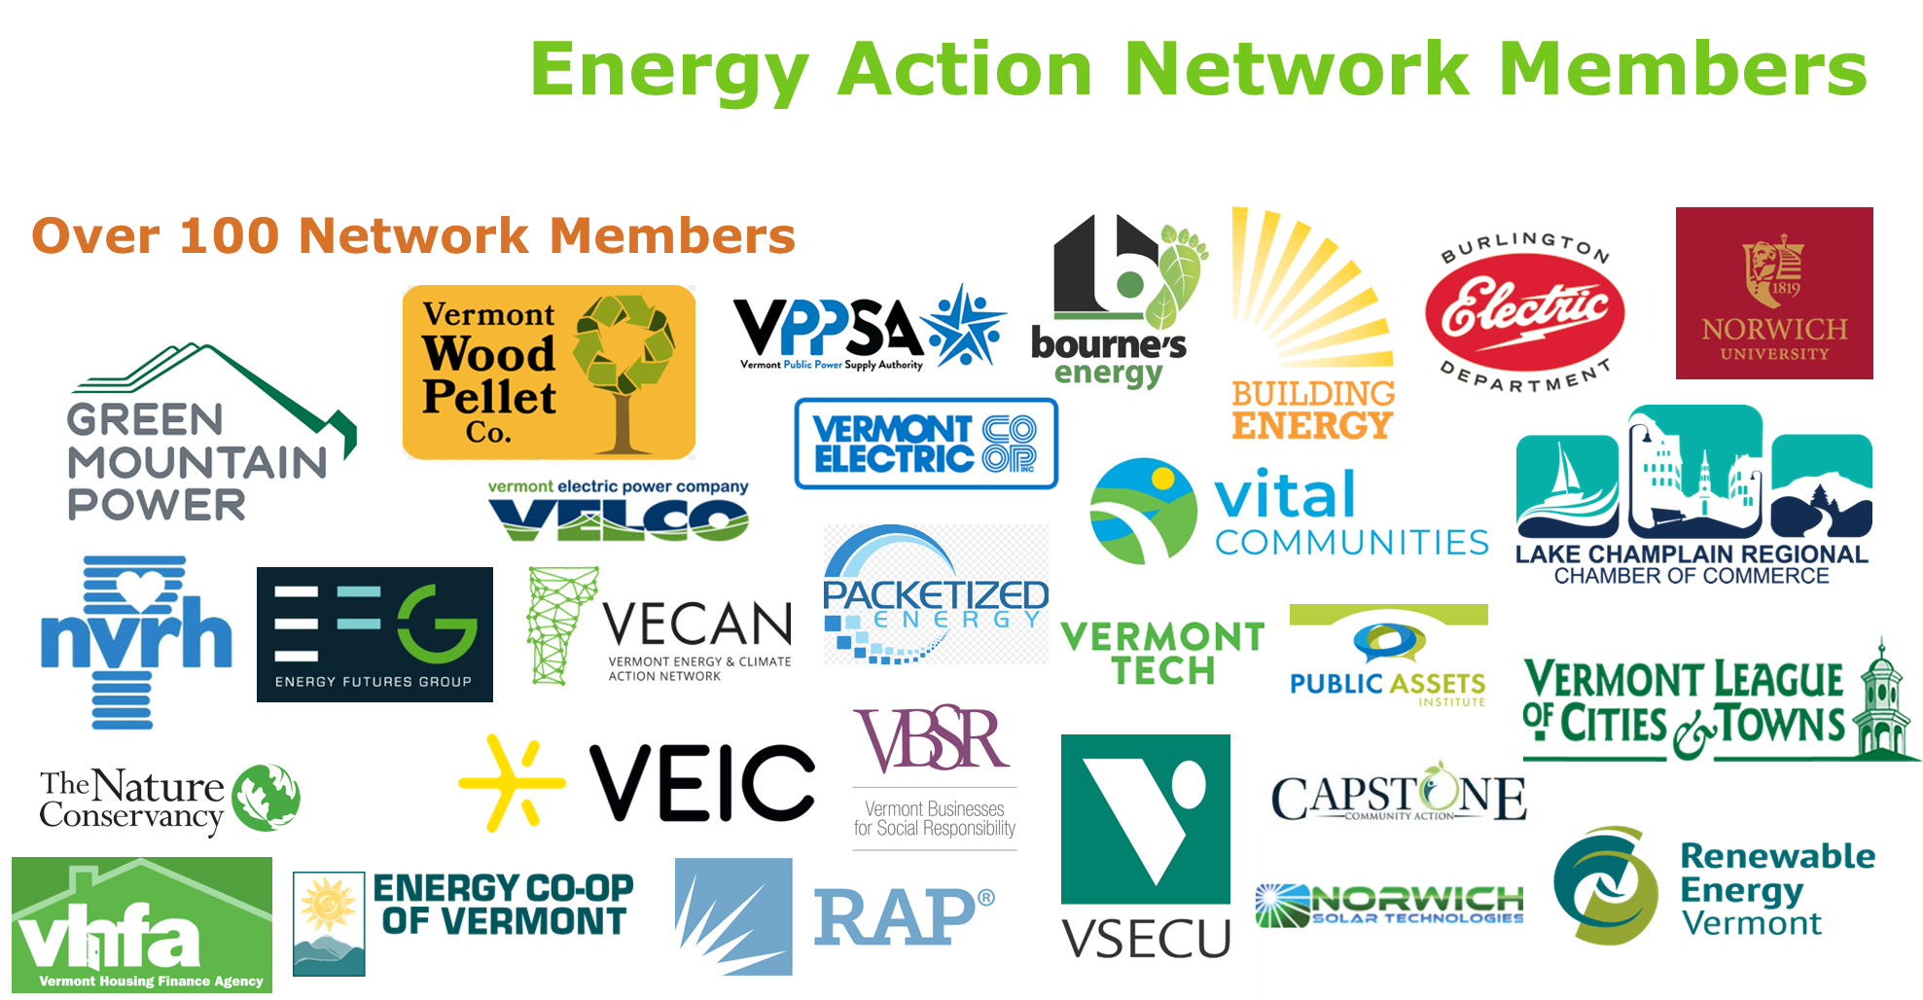

Slide 5
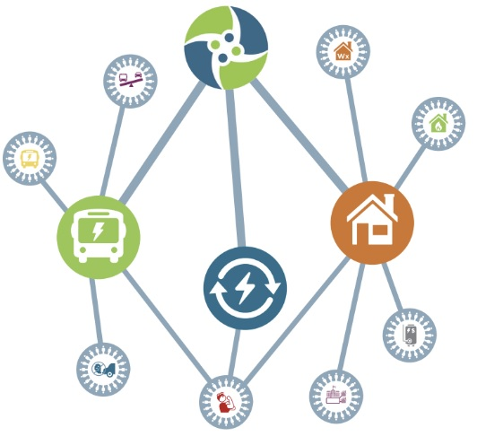
EAN Network Action Teams
Weatherization at Scale – 2020-present
Climate Workforce – 2021-present
Tenant Weatherization Protection – 2023-present
Thermal Energy Networks– 2022-present
Clean Heat Working Group – 2020-present
Transportation Cap & Invest – 2022-present
Switch & Save – 2021-present
Future of Rural Transit – 2020-present
Replace Your Ride – 2020-2021
Clean Transportation Equity – 2021-2022
Notes:
Much of our work together as a Network takes place through the structure of Network Action Teams.

Slide 6
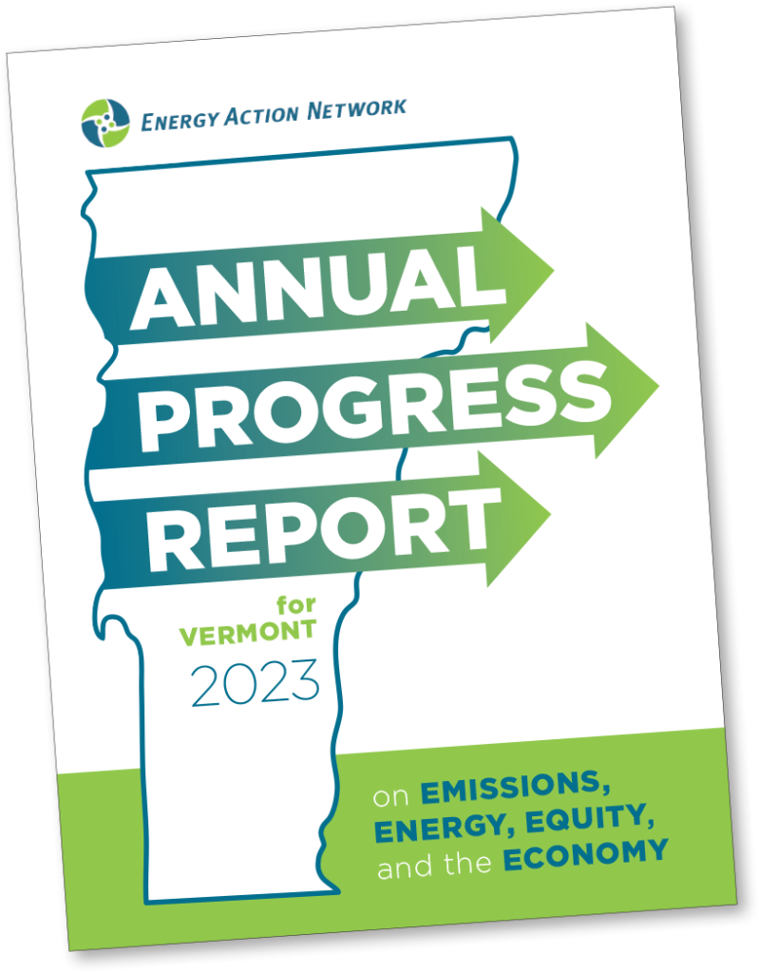
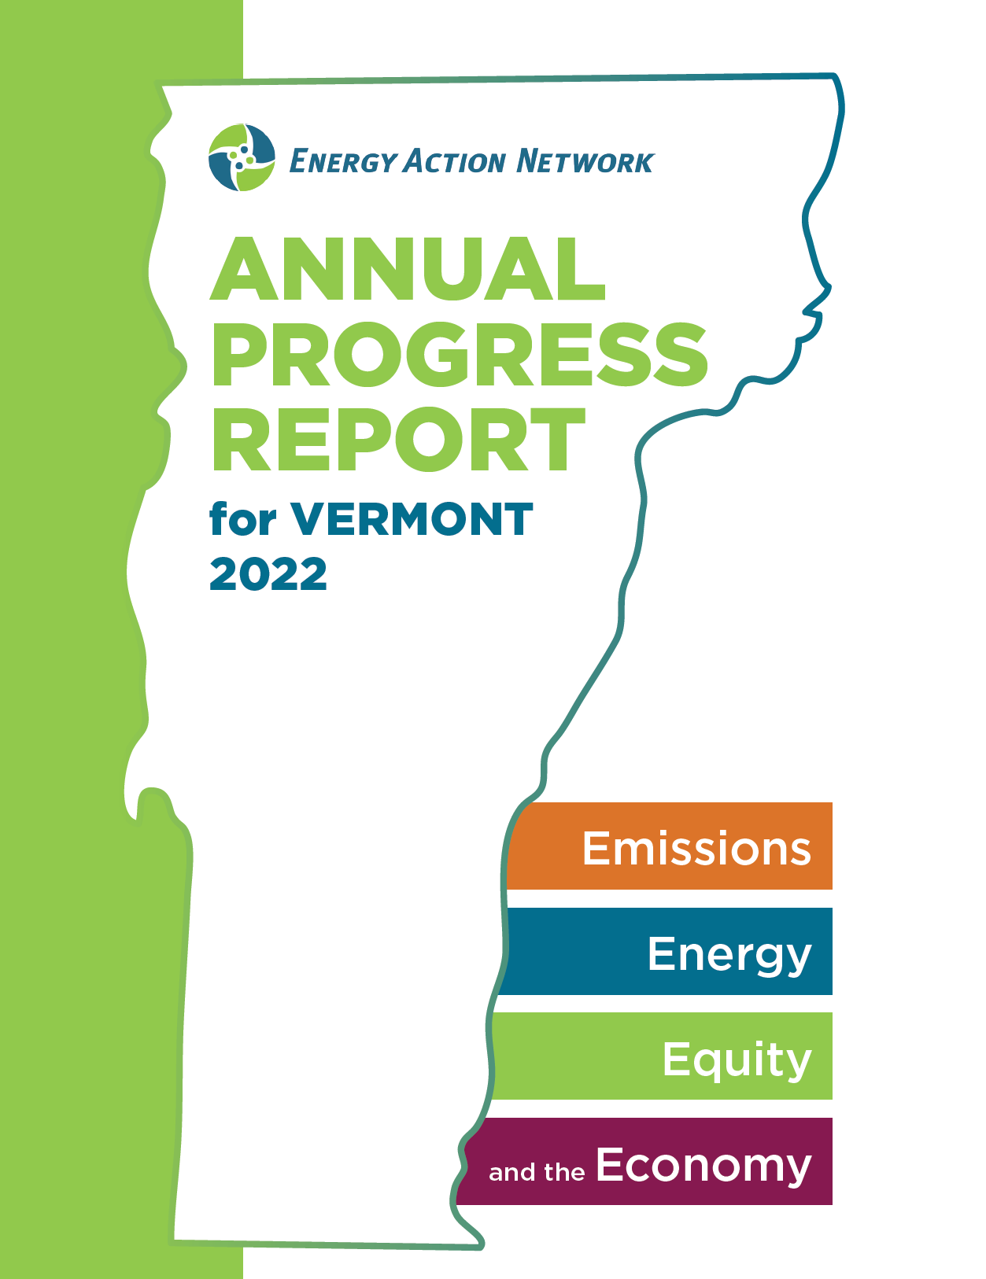
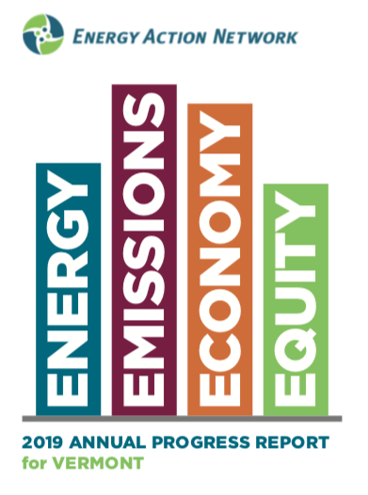
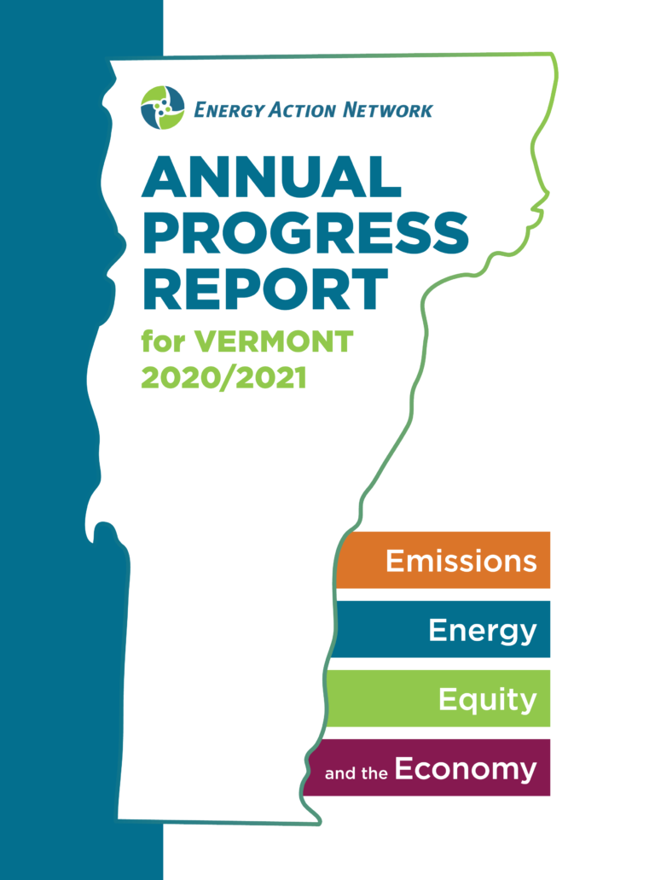
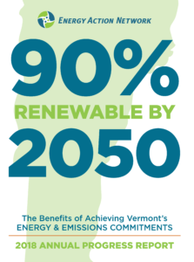
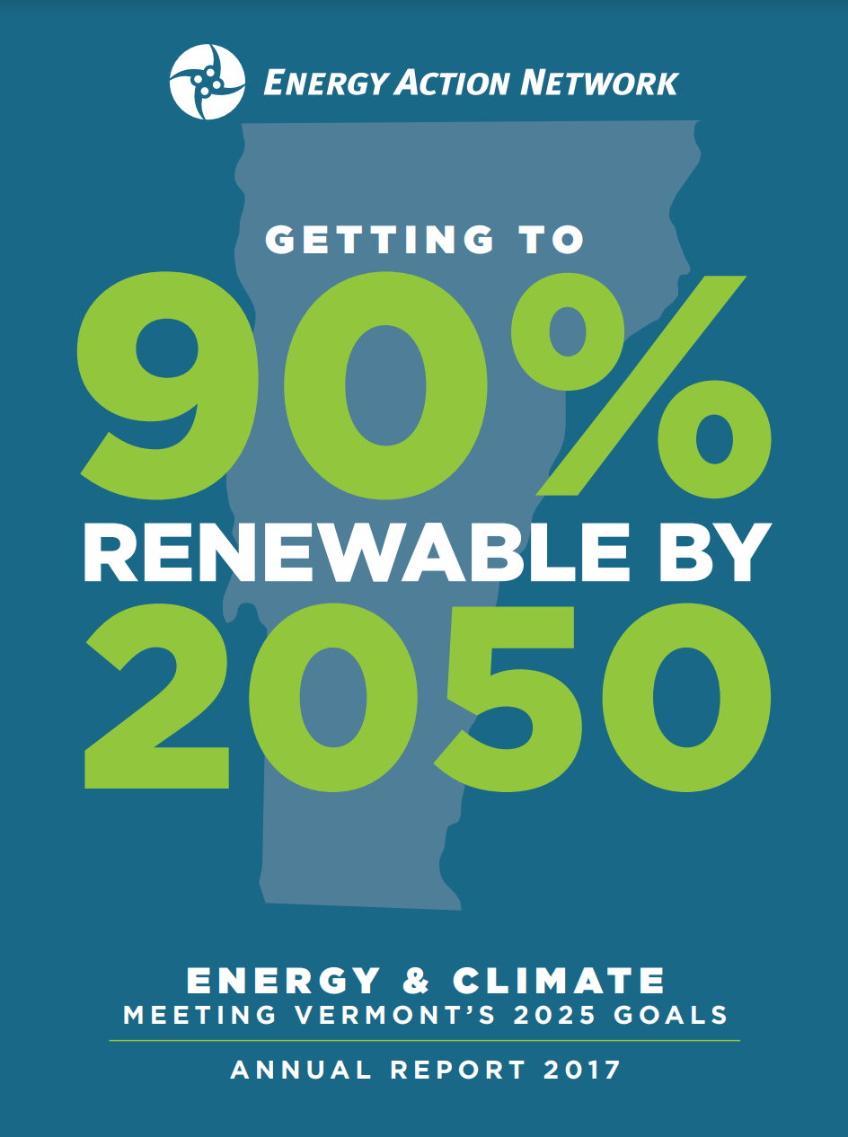
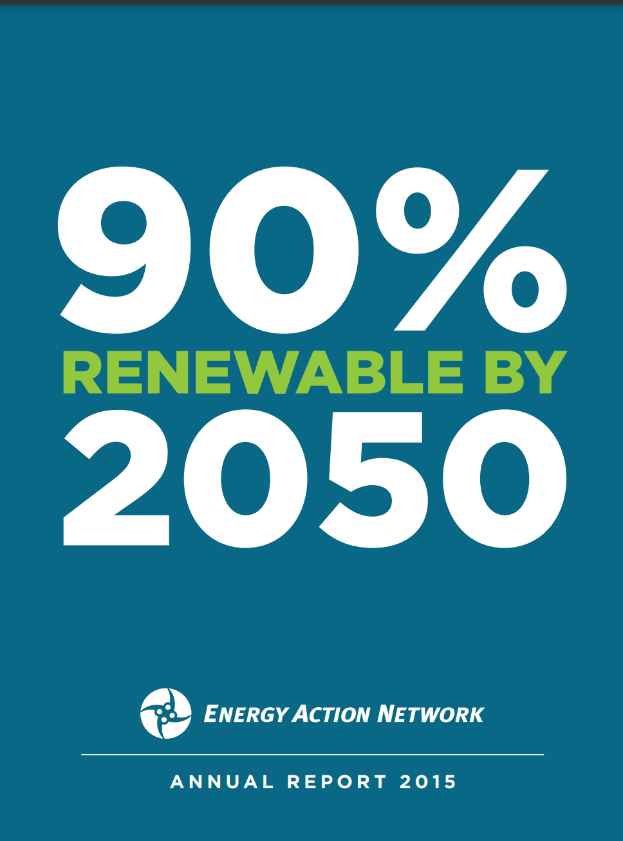
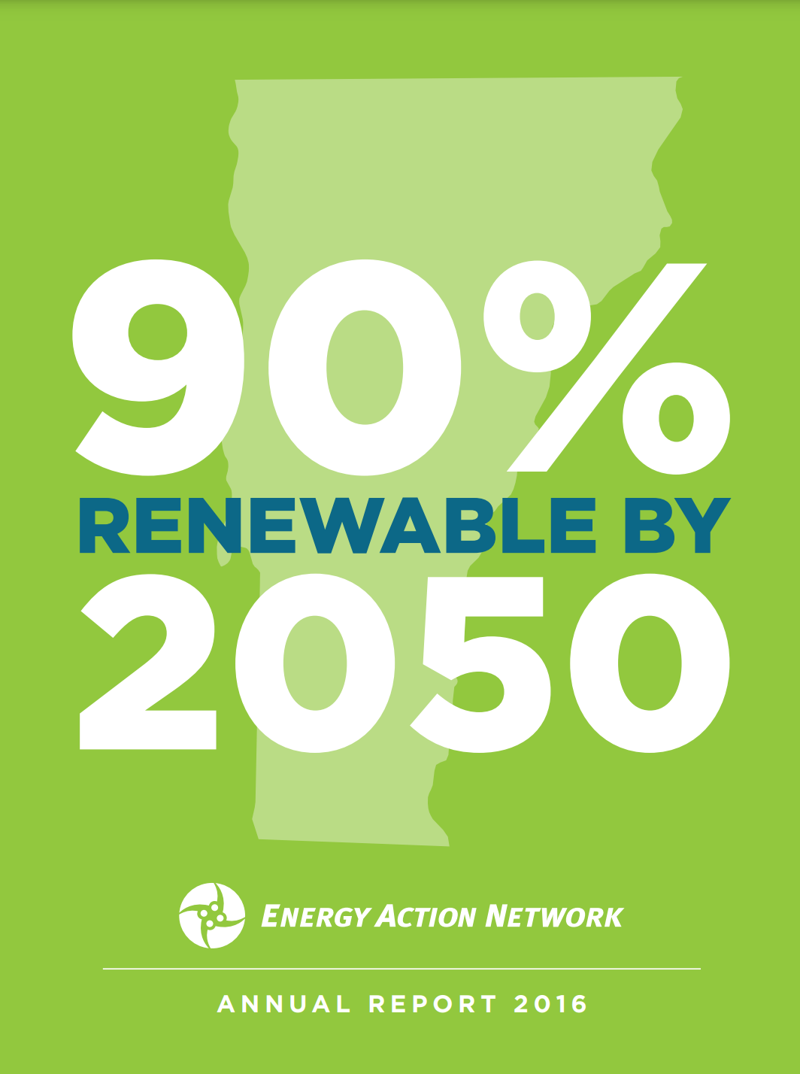
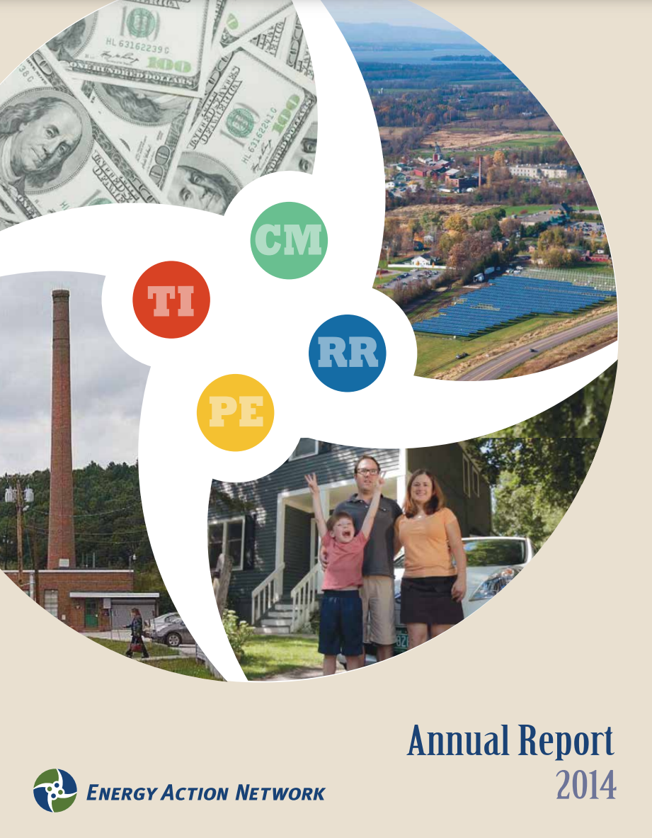
Data & Analysis
Notes:
The Energy Action Network as a non-profit is probably best known for our deep data gathering and analysis, which we present each year in an Annual Progress Report for Vermont, as well as through other research papers, webinars, the Leveraging Change Speakers series, and presentations around the state. Our next Leveraging Change Speaker Series will be in Burlington on December 5th. More information is available on our website at eanvt.org
With that, it is my pleasure to hand it over to my colleagues, Jared Duval and Lena Stier who will share the findings of our latest research paper.

Slide 7
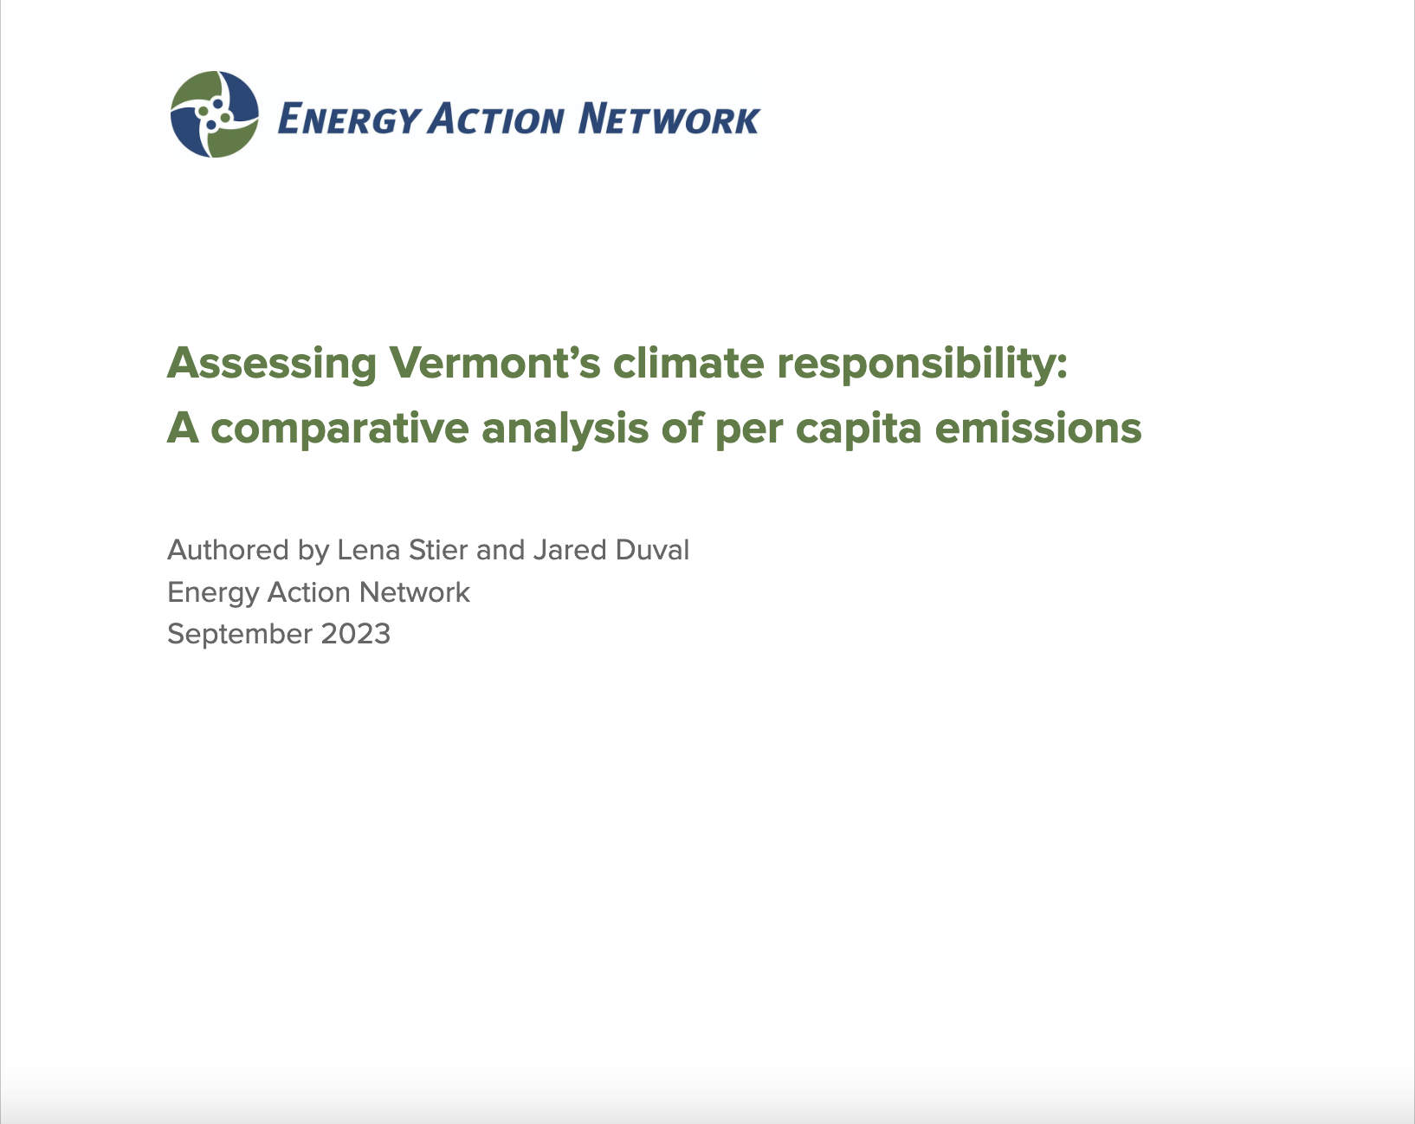
What we’ll cover today:
Per capita emissions comparison across New England
Largest sources of climate pollution by state and why
State emissions in a global context
A historical view of climate responsibility
Climate action as collective action
Economic opportunity of a transition to cleaner and more efficient energy
Notes:
Jared

Slide 8
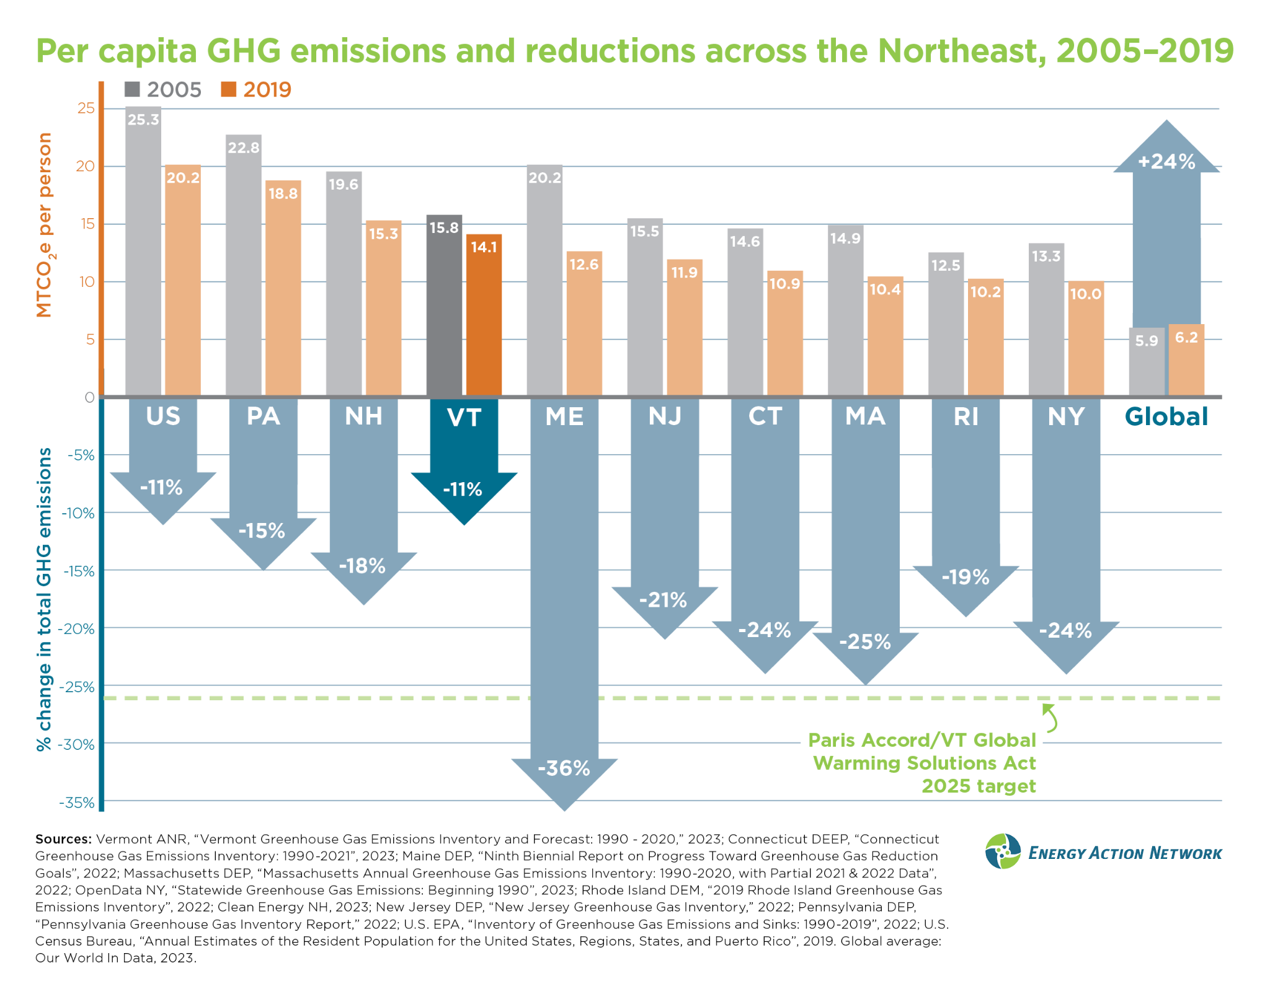
VT has 2nd highest per capita emissions in New England, 3rd highest in Northeast
VT has made least progress toward 2025 Paris Accord target
Notes:
Jared.
Often we hear about statewide total emissions and the differences between small and large states. When it comes to total emissions, not surprisingly the emissions of states largely mirrors their population size. But if we accept that each state has a responsibility to reduce the pollution that they create – a responsibility to do their fair share toward meeting science based reduction targets – then per capita emissions become a very important basis of comparison across states, accounting for differences in population.
Set the policy context (Paris, GWSA). VT least progress to Paris but all states have more to do, especially as we look to 2030.
First, the bottom half of this graph shows that Vermont has made the least progress of any state in the Northeast toward the Paris Climate Accord emissions reduction commitment made by the U.S. and is not on track to meet our own state legal obligations by 2025 and 2030 under the Global Warming Solutions Act. Vermont’s emissions reduction commitments in the Global Warming Solution Act align with and have Vermont doing our part to help meet the federal commitments. Specifically, as of 2019, which is the latest year that emissions data is available for comparison across all states in the region, Vermont has only reduced emissions 11% below 2005 levels, as you can see here, although the Paris target and the GWSA obligation are a 26% reduction below 2005 levels by 2025.
Vermont also has the 2nd highest per capita emissions in New England, behind only New Hampshire, and the 3rd highest in the entire Northeast, with only Pennsylvania and New Hampshire creating more climate pollution per person.
Looking internationally, Vermont’s per capita climate pollution is more than twice as high as the global average (see the bars on the far right, for comparison) and is significantly higher than most countries.

Slide 9
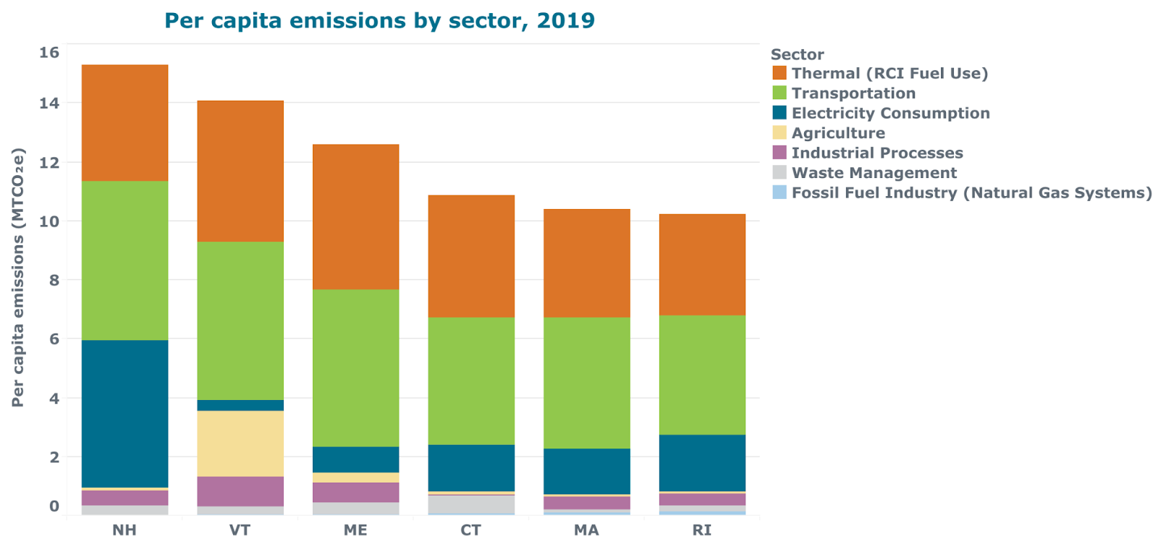
Per capita GHG emissions by sector
Notes:
Lena
This graph narrows in on just the 6 states within New England, and breaks down their per capita emissions by sector. Across New England, the transportation and thermal sectors (shown in green and orange, respectively) are the largest contributors to GHG emissions. In Vermont those two sectors represented 72% of our overall emissions in 2020. The transportation and thermal sectors are followed by the electricity sector in most states (shown in blue). We’re going to dive into each of these three energy sectors, transportation, thermal, and electricity.

Slide 10
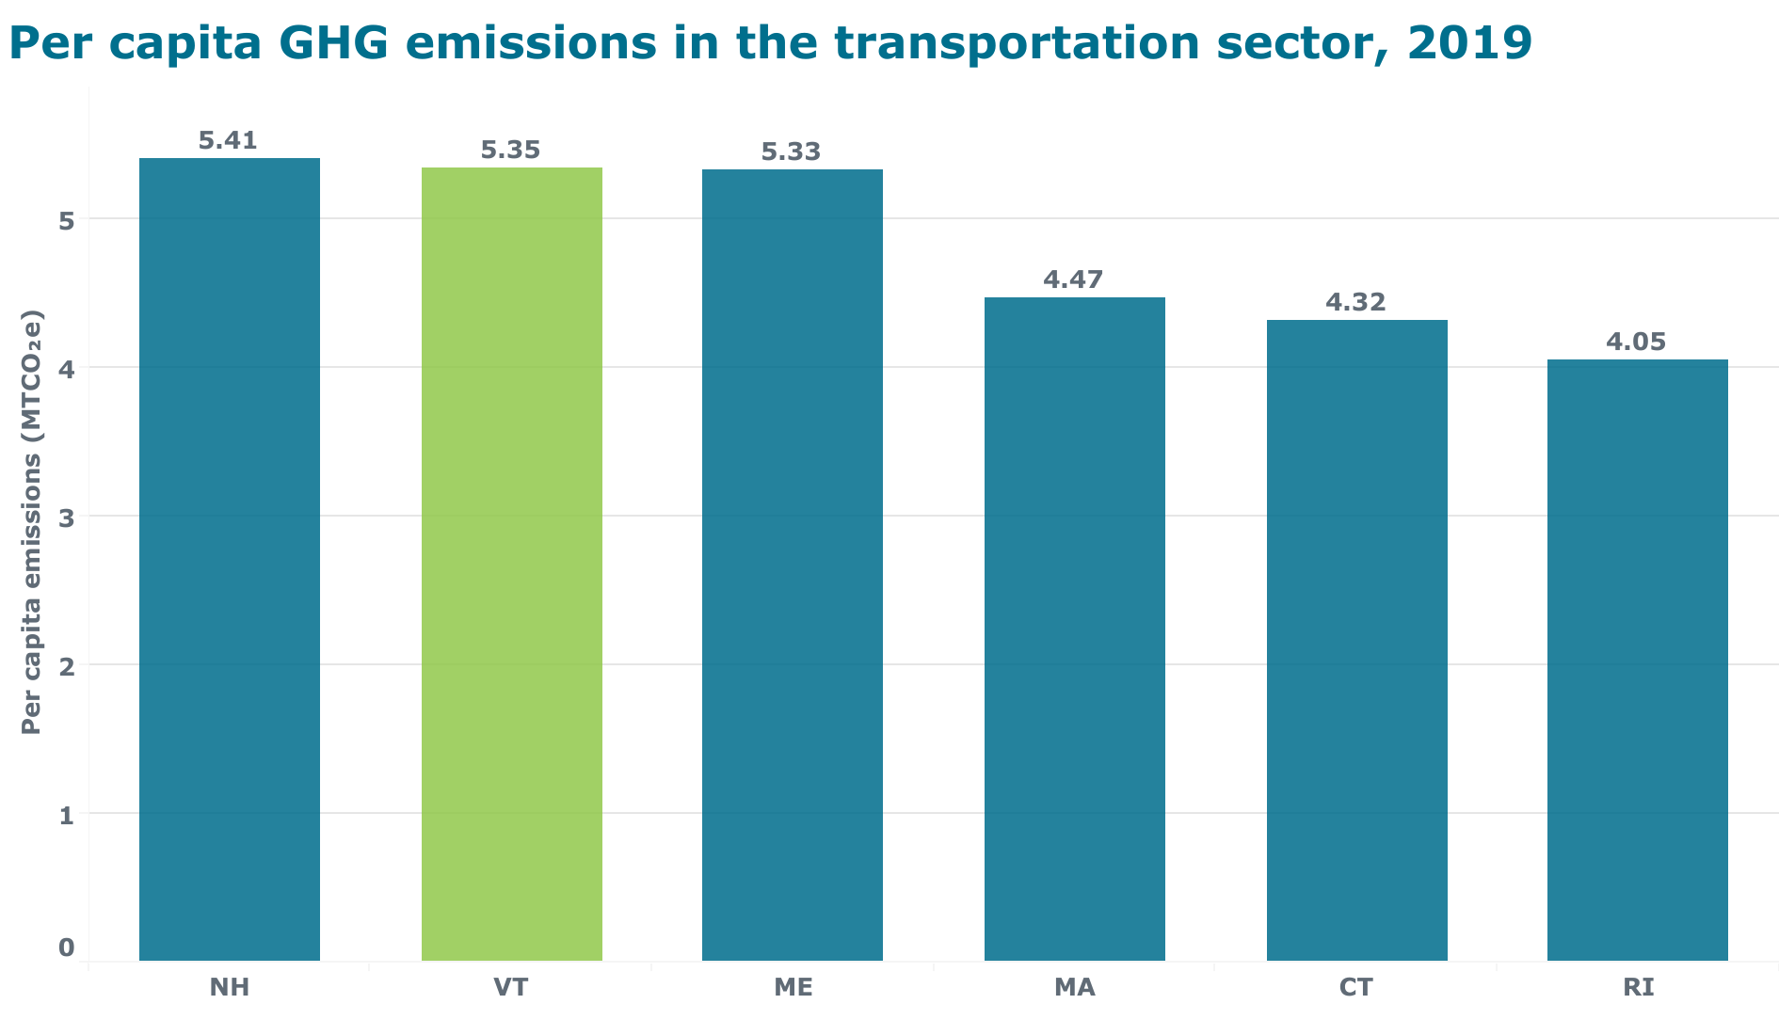
Transportation sector
Notes:
Lena
Looking more closely at the transportation sector, we can see that Vermont’s per capita emissions are second highest, right in between New Hampshire and Maine. VT, NH, and ME are quite similar when it comes to transportation emissions, and we’ll see why in the next couple of slides.

Slide 11
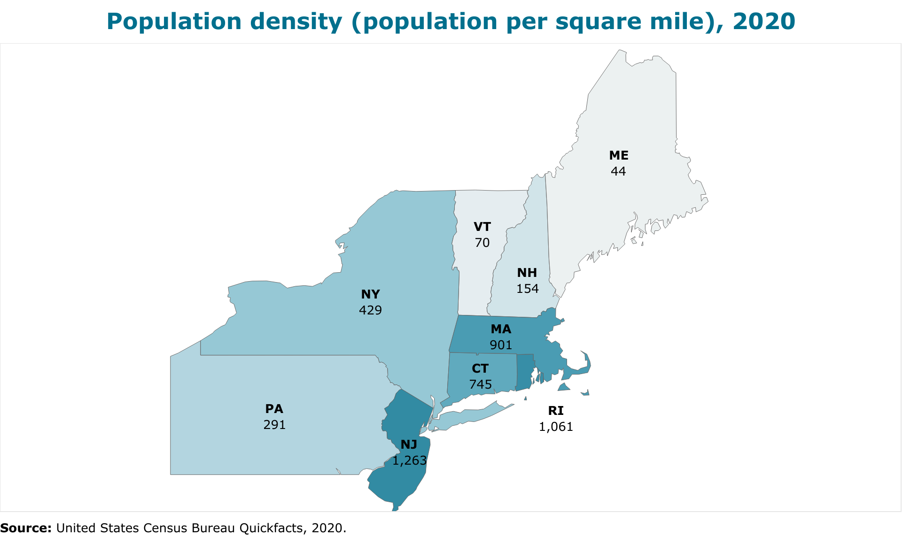
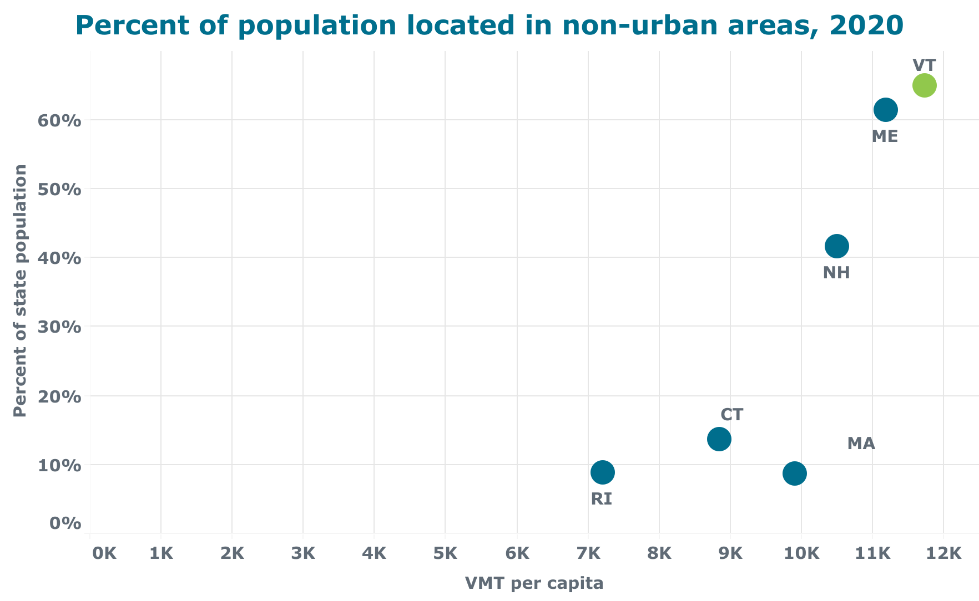
Transportation sector
Notes:
Lena
The biggest factor that goes into a state’s transportation emissions is the amount of fuel used in our vehicles, particularly in light-duty gasoline vehicles (which made up over 70% of VT’s transportation emissions in 2020). Because nearly 98% of VT vehicle fleet is made up of ICE vehicles, this is largely driven by the average annual vehicles miles traveled per person. We can see that Vermont, New Hampshire, and Maine all have significantly lower population densities and higher percentage of their populations living outside of urban areas relative to the rest of New England. Around 65% of Vermont’s population lives outside of urban areas, compared to right around 10% in Rhode Island, Massachusetts, and Connecticut.

Slide 12
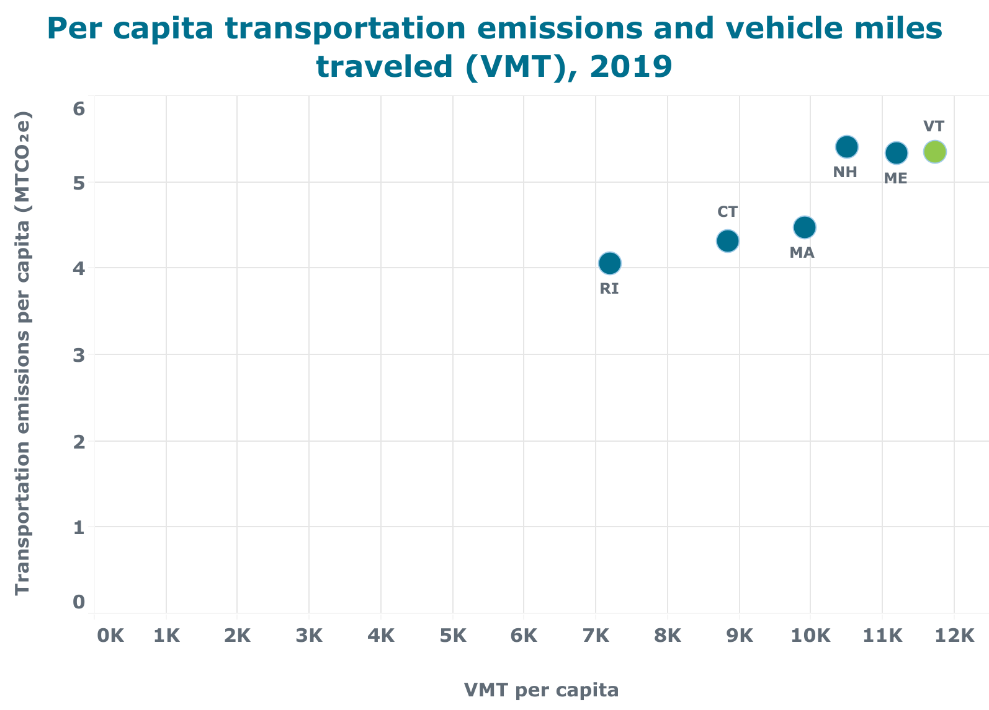
Transportation sector
~98% of VT’s vehicle fleet are gas or diesel vehicles
Vermonters drive more, on average, than the rest of New England
Correlation between VMT and per capita transportation emissions
Notes:
Lena.
That trend carries over to vehicle miles traveled (or VMT) per capita, with those three states coming in higher than the rest of New England. In this graph, we can see a clear correlation between per capita transportation emissions and VMT per capita.
Again, we know that currently about 98% of VT’s vehicle fleet are gas and diesel vehicles. Vermont recently surpassed 10,000 EVs registered in the state this year, which is a huge milestone, but that compares to a total light-duty gasoline fleet of over 590,000 vehicles. As Vermont and other states continue to transition vehicle fleets to more EVs and achieve cleaner electricity grids over time, we expect to see less of a fixed relationship between VMT and emissions. It’s because of the current overwhelming reliance on gasoline and diesel vehicles that this correlation is so strong.

Slide 13
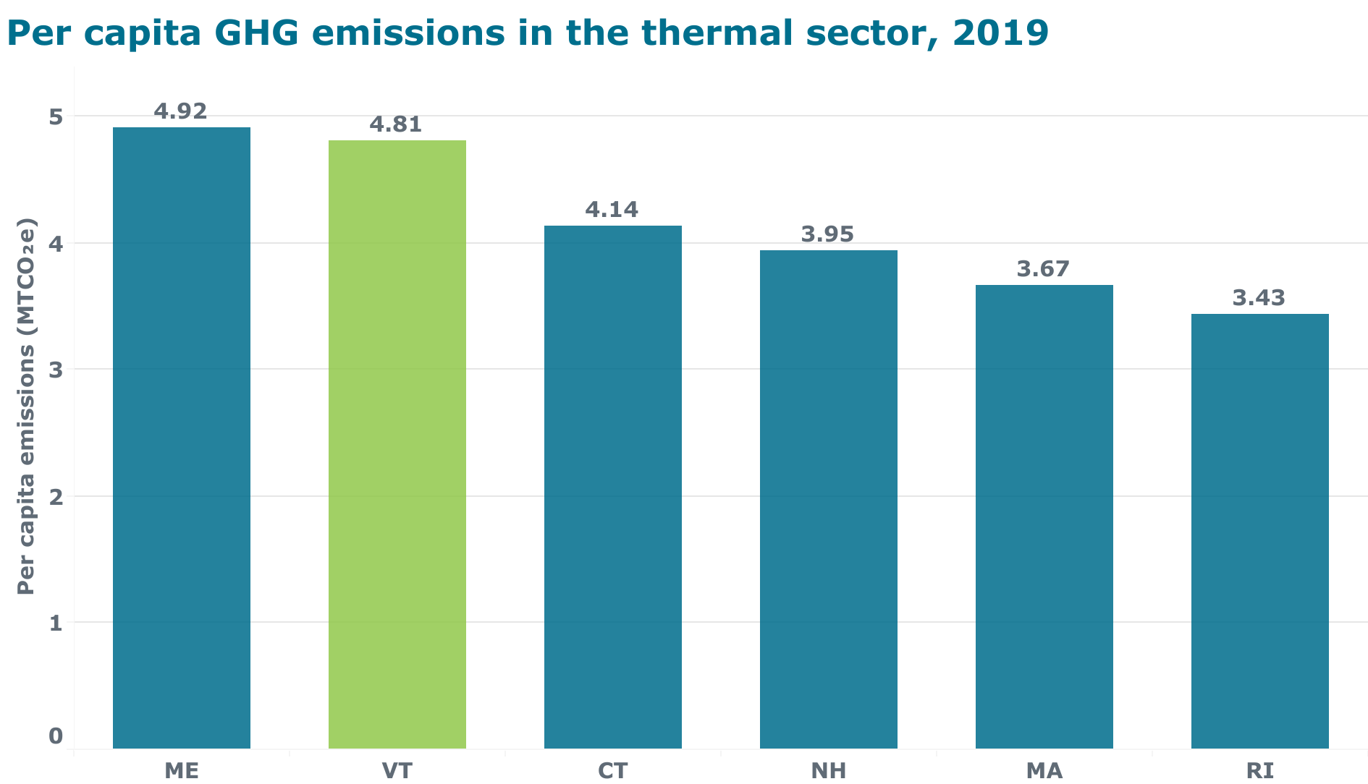
Thermal sector
Notes:
Jared. Here we see the states with the highest per capita emissions from the thermal sector, also known as Residential, Commercial, and Industrial fuel use and this primarily represents emissions from fossil fuels used for heating. Maine and Vermont emit the most climate pollution per person in the thermal sector primarily as a result of two factors..

Slide 14
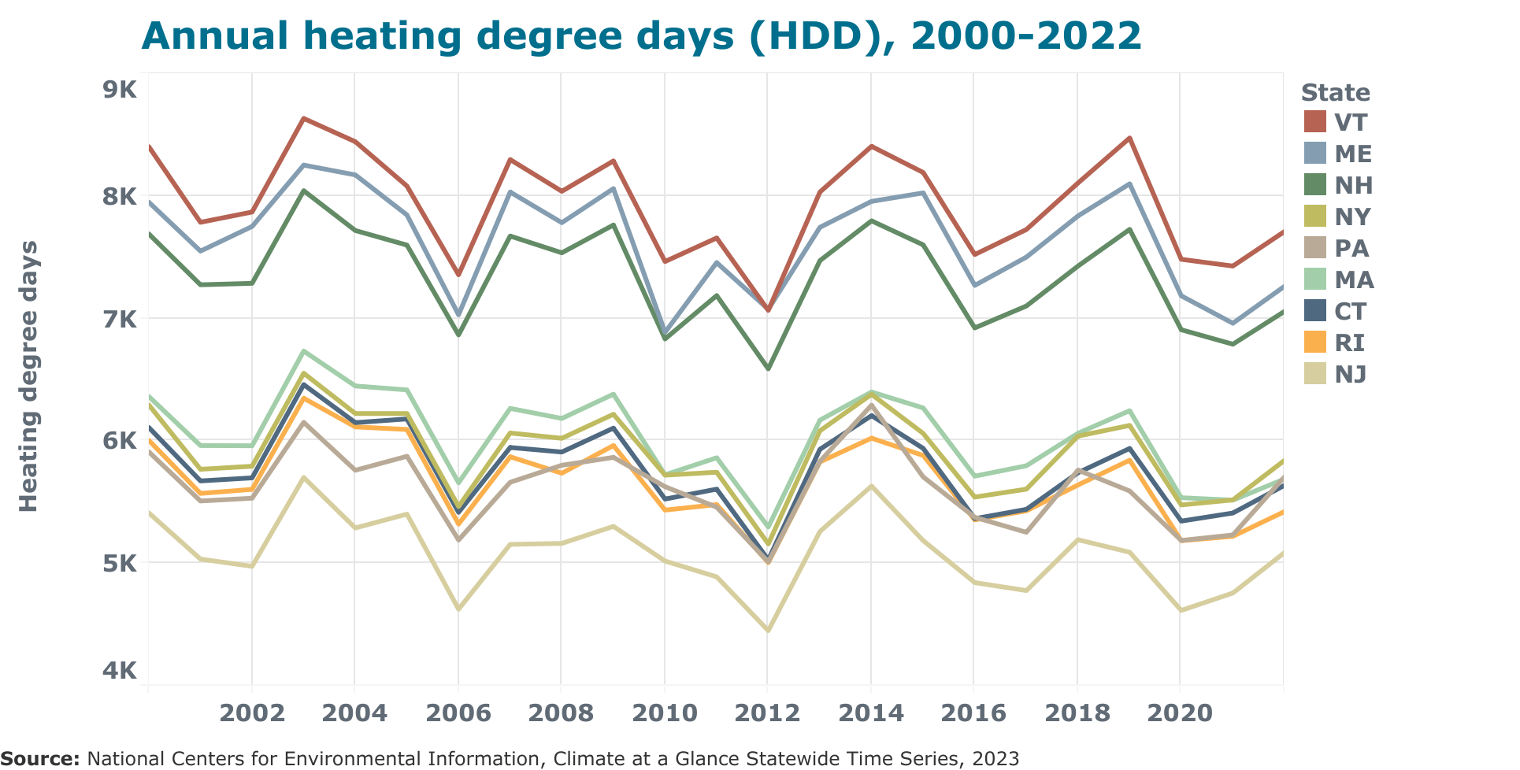
Thermal sector
Notes:
Jared-
1) those states have the coldest winters in the region, as measured by heating degree days.
Note: Heating degree days are calculated as the difference between the daily average temperature and a standard temperature (often 65 degrees F). To get annual heating degree days, the daily values are summed over a year. Because of this, annual HDD’s are often in the thousands. (*share if timing seems on track)

Slide 15
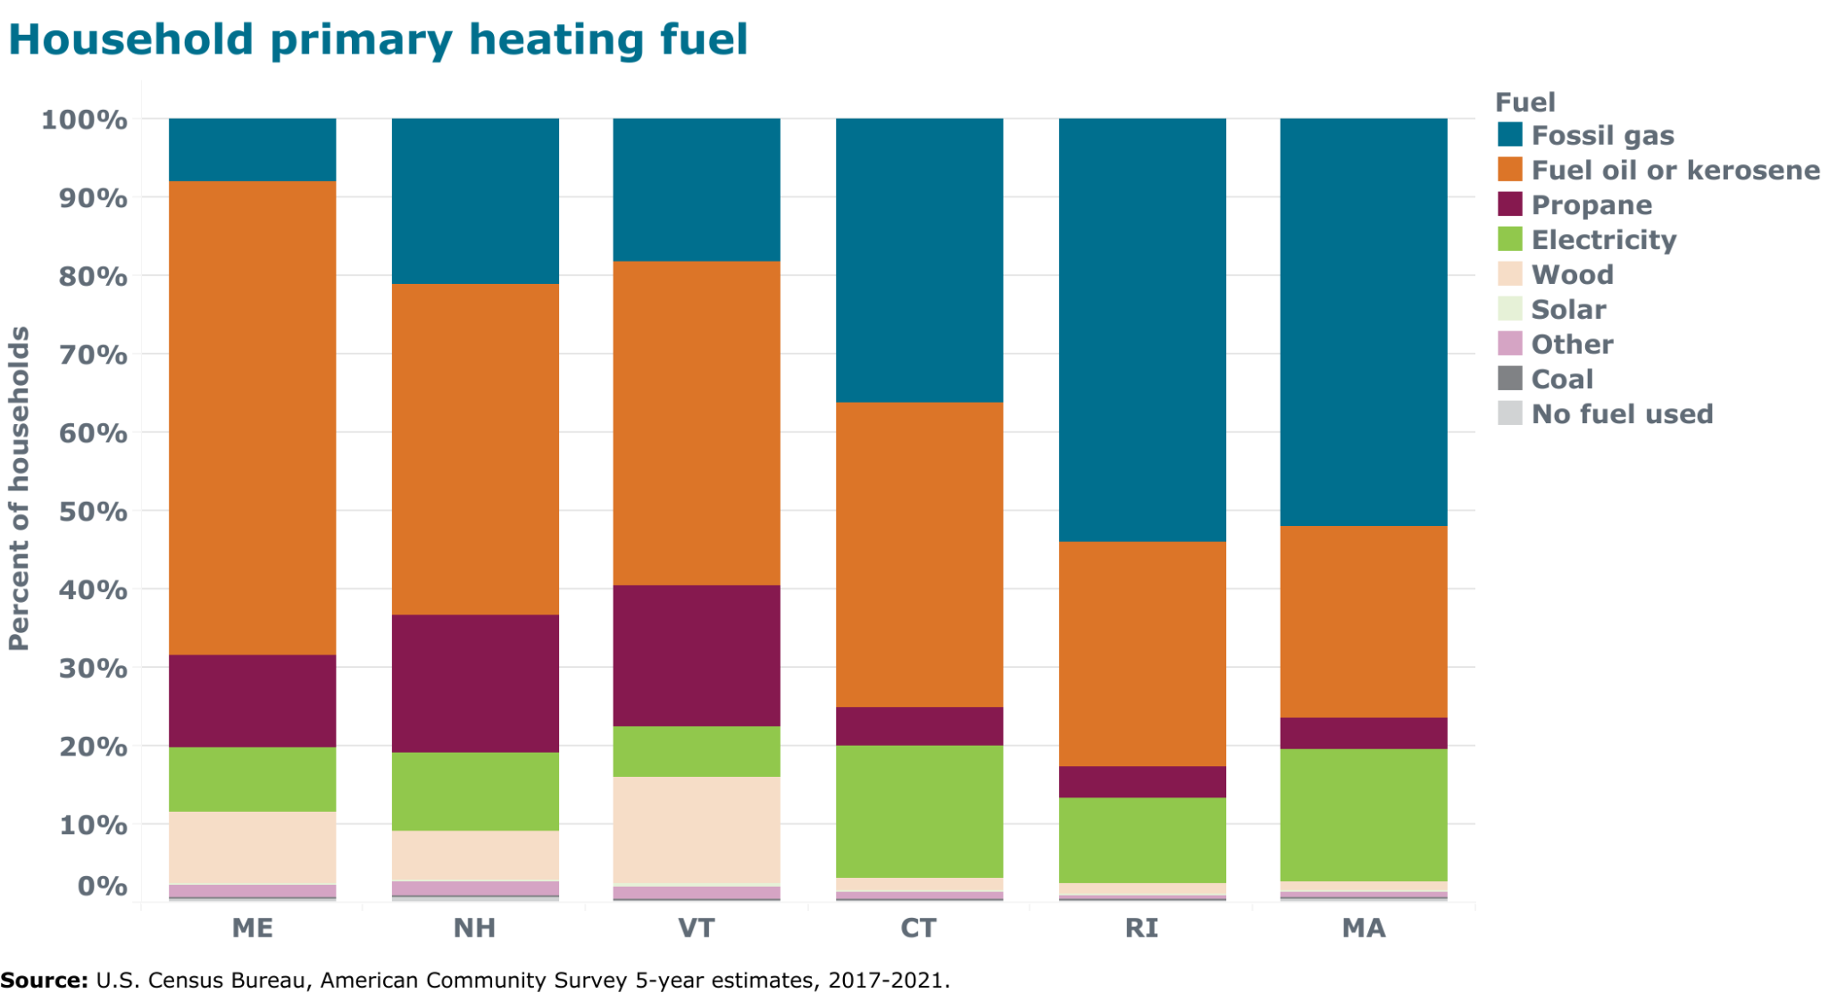
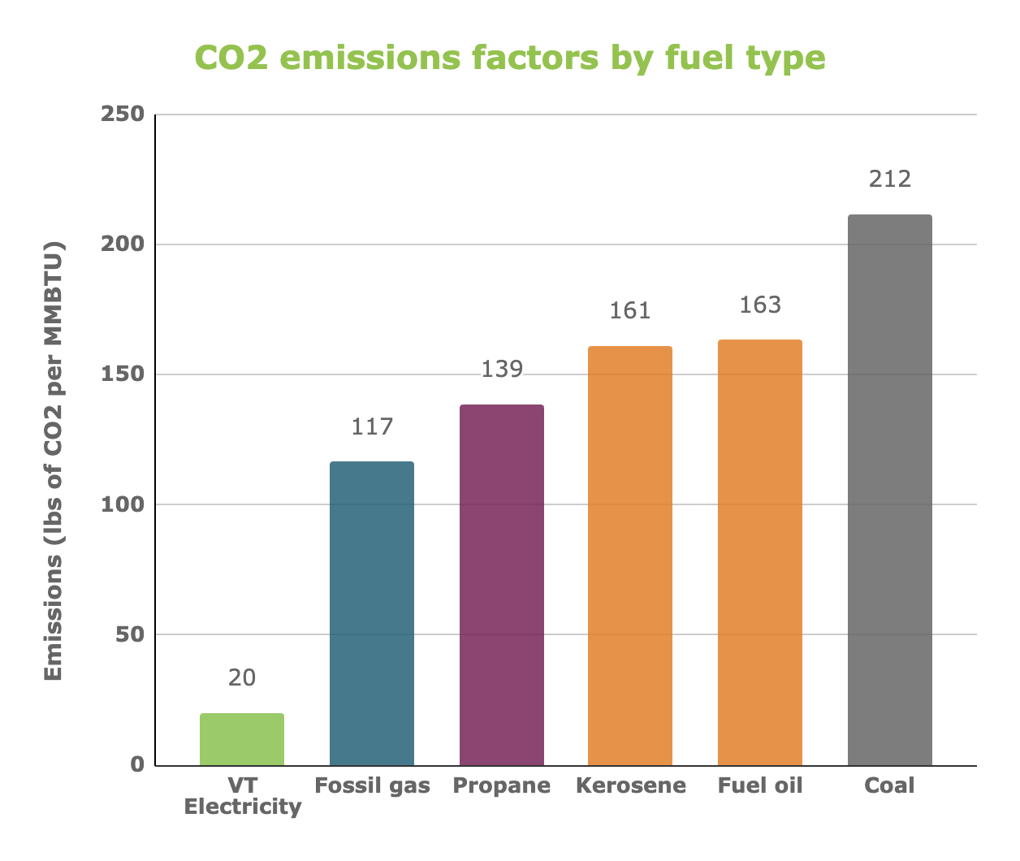
Thermal sector
Notes:
Jared -
And 2) Maine and Vermont are the states that are most dependent on the most carbon intensive heating fuels: fuel oil and propane. You can see the heating sources by state on the left hand graph. The graph on the right then compares those heating options by their carbon intensity (note that the electricity carbon intensity is specific to VT’s purchased portfolio, so that number is likely a little higher in other states (though still lower than all of the fossil fuels presented).
Going forward, the states that achieve the lowest thermal sector emissions will likely be those that are the most effective at transitioning to efficient electric technology via heat pumps and heat pump water heaters. This is especially true for Vermont, which has the least carbon intensive electricity portfolio of any state in the country, let alone the Northeast.

Slide 16
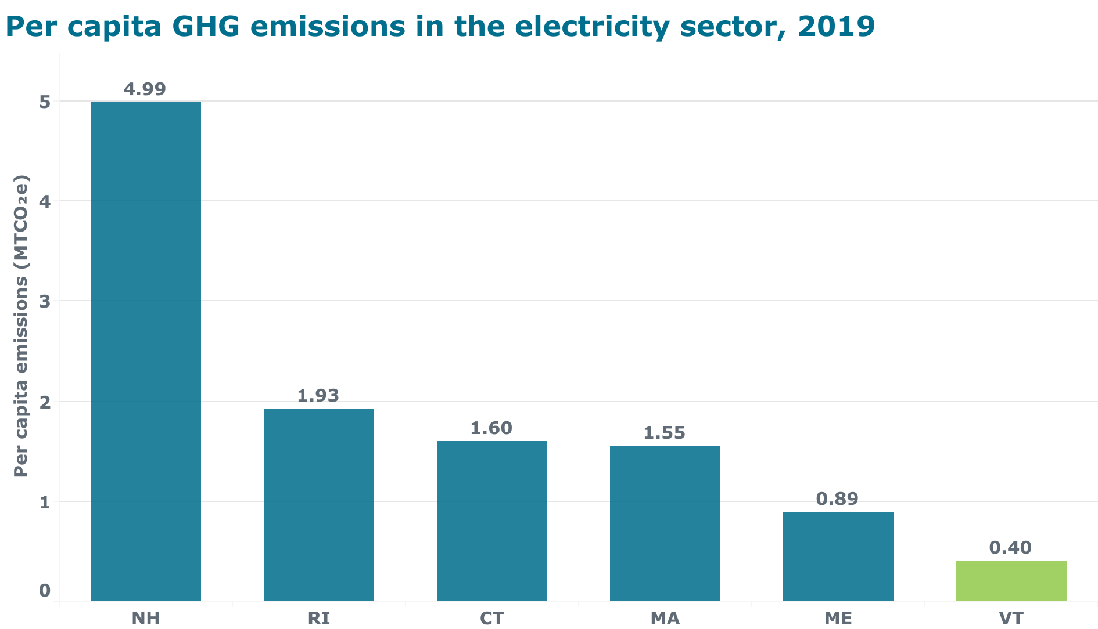
Electric Sector
Notes:
Jared - This graph shows a comparison of emissions from electricity use, per person, by state. While electricity consumption is not as much of a source of GHG emissions for most states in New England, NH’s very high electric sector emissions are a significant factor as to why it has the highest per capita emissions in the region. This primarily reflects that the electricity purchased by New Hampshire is much more fossil fuel based than the cleaner and more renewable electricity portfolios required by law in all other New England states.

Slide 17
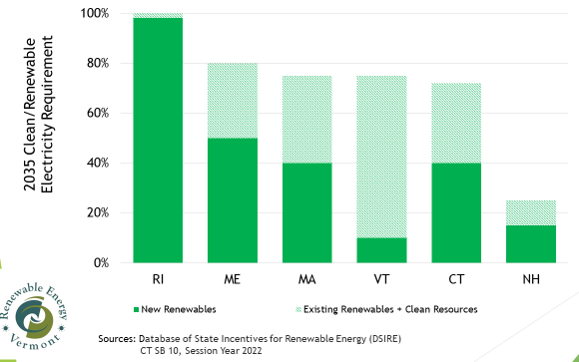
Electric Sector
Notes:
Jared -
This is a graph we borrowed from our friends at Renewable Energy Vermont. Notice the total height of the bars – while New Hampshire currently only requires 25% of its electricity to come from clean or renewable sources by 2025, every other state in New England requires at least 70% by 2035. VT is 75% by 2032. Rhode Island 100% by 2033. Maine is 80% by 2030. Look up MA, CT…
See: https://www.ncsl.org/energy/state-renewable-portfolio-standards-and-goals#:~:text=Renewable%20Portfolio%20Standards%20(RPS)%20require,production%20and%20encourage%20economic%20development

Slide 18
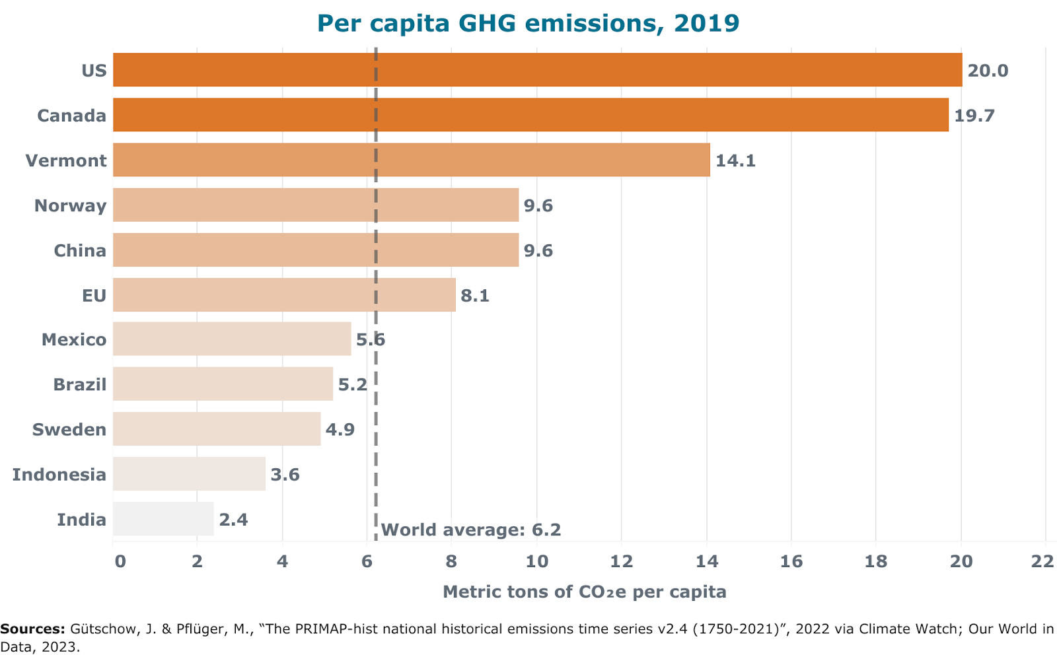
Looking Globally
Vermont’s per capita emissions are more than 2x the global average.
Notes:
Lena
As part of this research, we also looked beyond the Northeast to better understand how Vermont’s per capita emissions compare globally. While the per capita emissions of all six New England states, including Vermont, are lower than the average per capita emissions of the US as a whole, they are significantly higher than those of most countries around the world. In fact, Vermont’s per capita emissions are more than two times higher than the global average (dotted line) of just over 6 metric tons per person, and are much higher than China, India, and the EU.
This is an important point in bringing climate justice and equity into the conversation, particularly when it comes to understanding what an equitable distribution of the costs and benefits of addressing the climate crisis should look like.

Slide 19
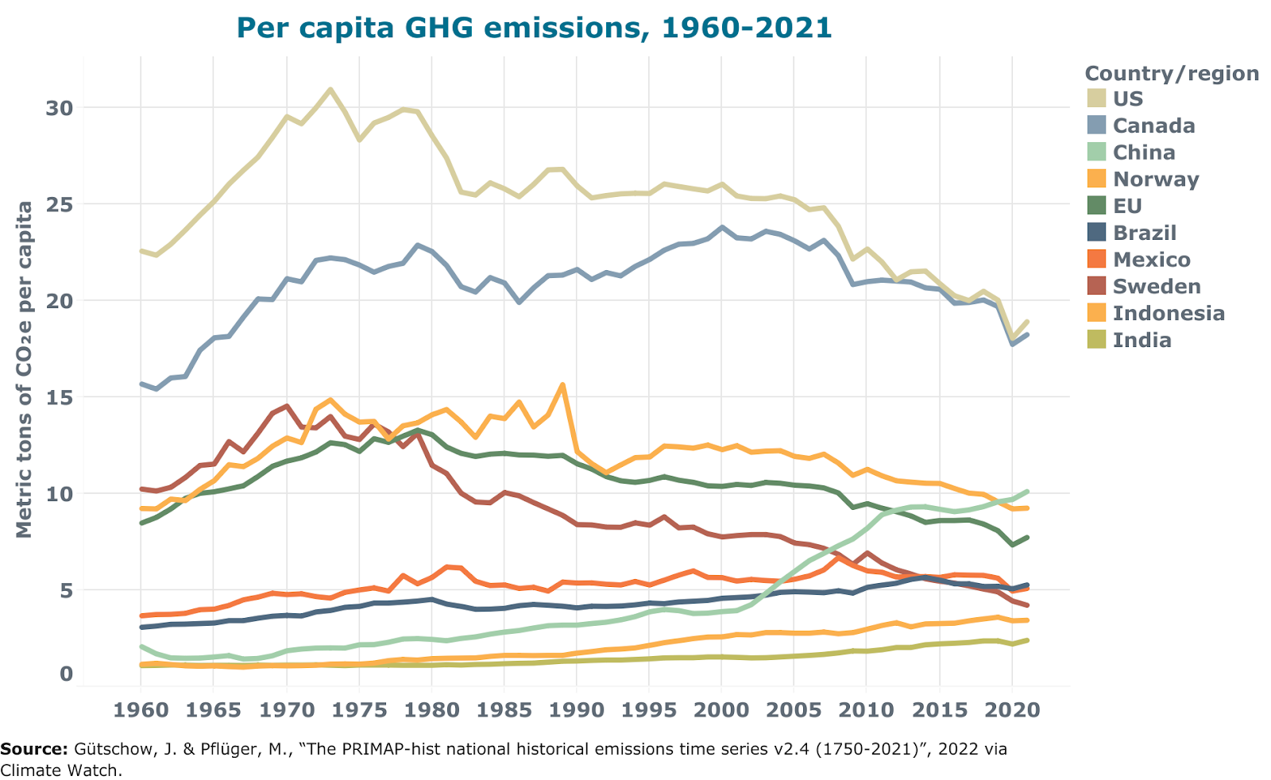
Notes:
Lena
When we look at historical emissions over time, as well, we can see that places like the US and Canada not only emit more on a per capita basis but have also historically had far higher per capita emissions than other parts of the world. This graph just shows annual per capita emissions since 1960, but this trend has contributed to these same countries having significantly higher total cumulative emissions over time.

Slide 20
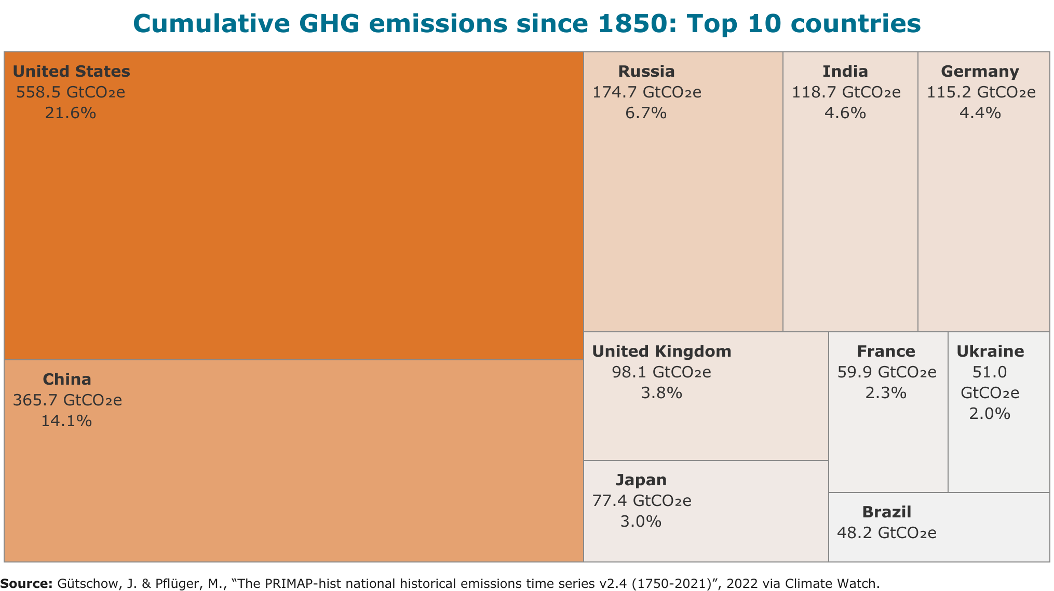
The US is responsible for more than 20% of total historical GHG emissions since 1850.
Notes:
Lena
We can think of cumulative emissions as the extent to which a state or country has played a role in producing the climate destabilization we see today. The United States, which has relied heavily on burning fossil fuels for nearly two centuries, is responsible for over 20% of total global cumulative emissions since 1850.
EAN generated a rough estimate of how much Vermont has emitted, cumulatively, from 1850 to 2019. We found that Vermont’s cumulative emissions are likely higher than those of over 70 countries, many of which have much larger populations.

Slide 21
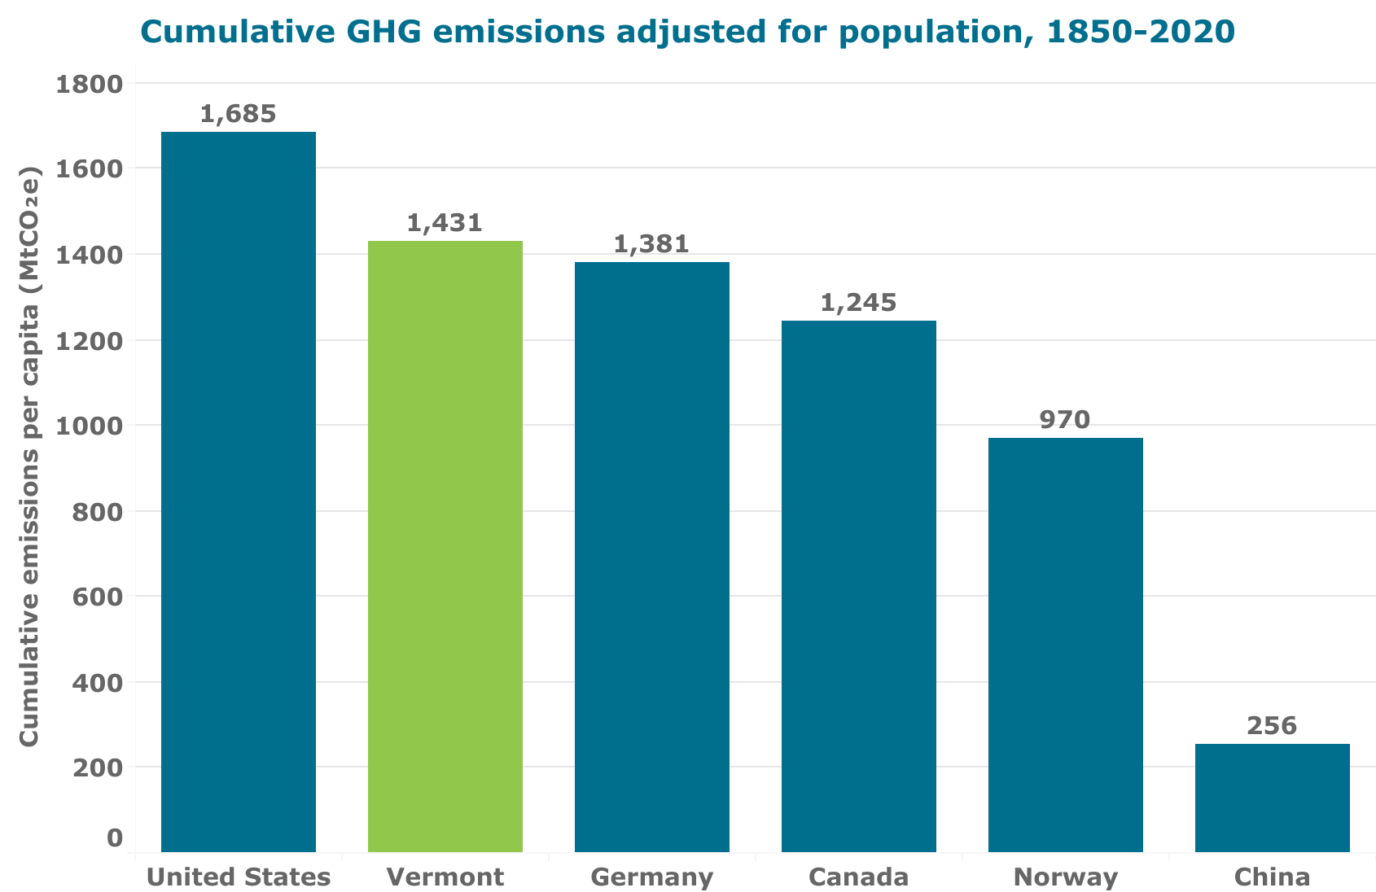
Notes:
Lena
Looking at cumulative emissions on a per capita basis allows for a fairer comparison between countries of different sizes as it accounts for differences in population. On a per capita basis, we estimated Vermont’s cumulative emissions to be among the highest in the world, right around the level of the US, Canada, and major economies within the EU.
We’ve looked at multiple different ways of expressing GHG emissions that can together help to build a better understanding of a state or country’s climate responsibility.

Slide 22
Collective climate action responsibility: like a barn raising
Notes:
Jared -
This isn’t just a scientific question – it’s also a social question. Many opponents of climate action in Vermont (and elsewhere) say that one state alone can not effectively respond to the climate crisis. Of course that’s true. However, that can be said of any and every state and country. That reality should be a cause for stepping up to do our part, rather than an excuse to step back and shirk responsibility. Effective climate action requires collective action, and that includes us taking responsibility for the pollution we create and acting to reduce it at the scale and pace that we have committed to with science-based targets.
One way to think about the responsibility that states and countries have is like a barn raising. No one person can raise a barn on their own, no matter how strong. Similarly, no one state or country alone can accomplish the task of averting the worst consequences of a destabilized climate. So each of us should pitch in, together. Whenever a person or a jurisdiction doesn’t do their part, it makes the task that much more difficult for others. It also sets a bad social example. Barn raisings show how we can accomplish large tasks through collective action, which is exactly what is necessary for effective climate action. As we write in the paper, “Effective mitigation of greenhouse gas emissions can only be achieved by a collective effort.”
Considering a state or country’s per capita GHG emissions or historical emissions over time, in addition to their total overall emissions, are important additional perspectives that help to build a stronger and more complete understanding of what that state or country’s role and responsibility within this collective effort ought to be.

Slide 23
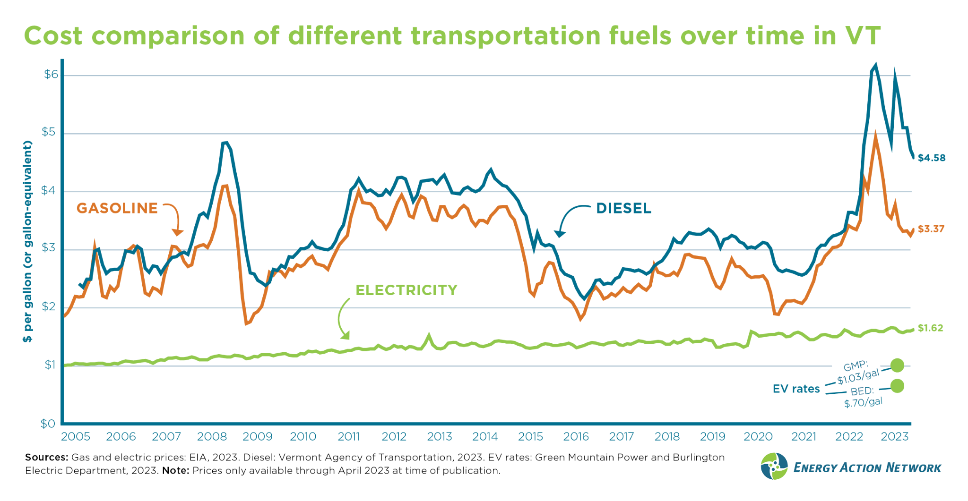
Notes:
Jared
Climate action at the state level is not just a legal obligation and a moral responsibility. It is also an economic opportunity – an opportunity to save people money and strengthen our economies. This graph compares the cost of different transportation fuels in Vermont: gasoline and diesel vs. electricity. As you can see, the prices for gasoline and diesel are, on average, much higher than electricity (in terms of $ per gallon or gallon-equivalent), and also experience much greater price volatility. In contrast, electricity – especially when using EV charging rates – is a much less expensive and more price stable option to meet our transportation needs.

Slide 24
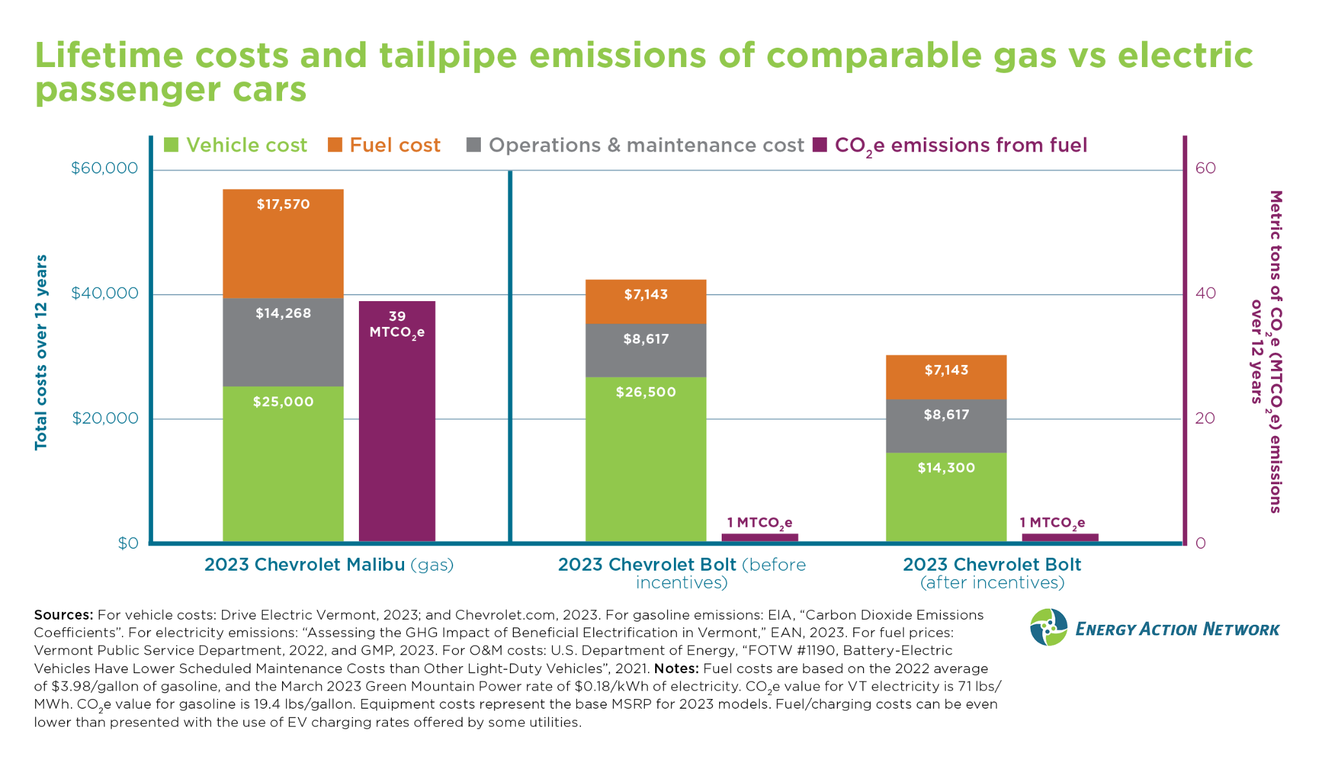
Notes:
Jared
And it’s not just about fuel cost savings. This graph compares the total estimated lifetime costs of two comparable vehicles: a gasoline Chevy Malibu and an all-electric Chevy Bolt. When looking at the all-in costs, including fuel and maintenance costs, EV’s cost less to operate and own than gas vehicles. Further, with federal, state, and utility incentives, the up-front cost of EVs is also now frequently lower than that of comparable gas vehicles (as seen in the stacked bar on the far right of the graph – notice the difference between the size of the green portion of the bars, pre- and post-purchase incentives being factored in).

Slide 25
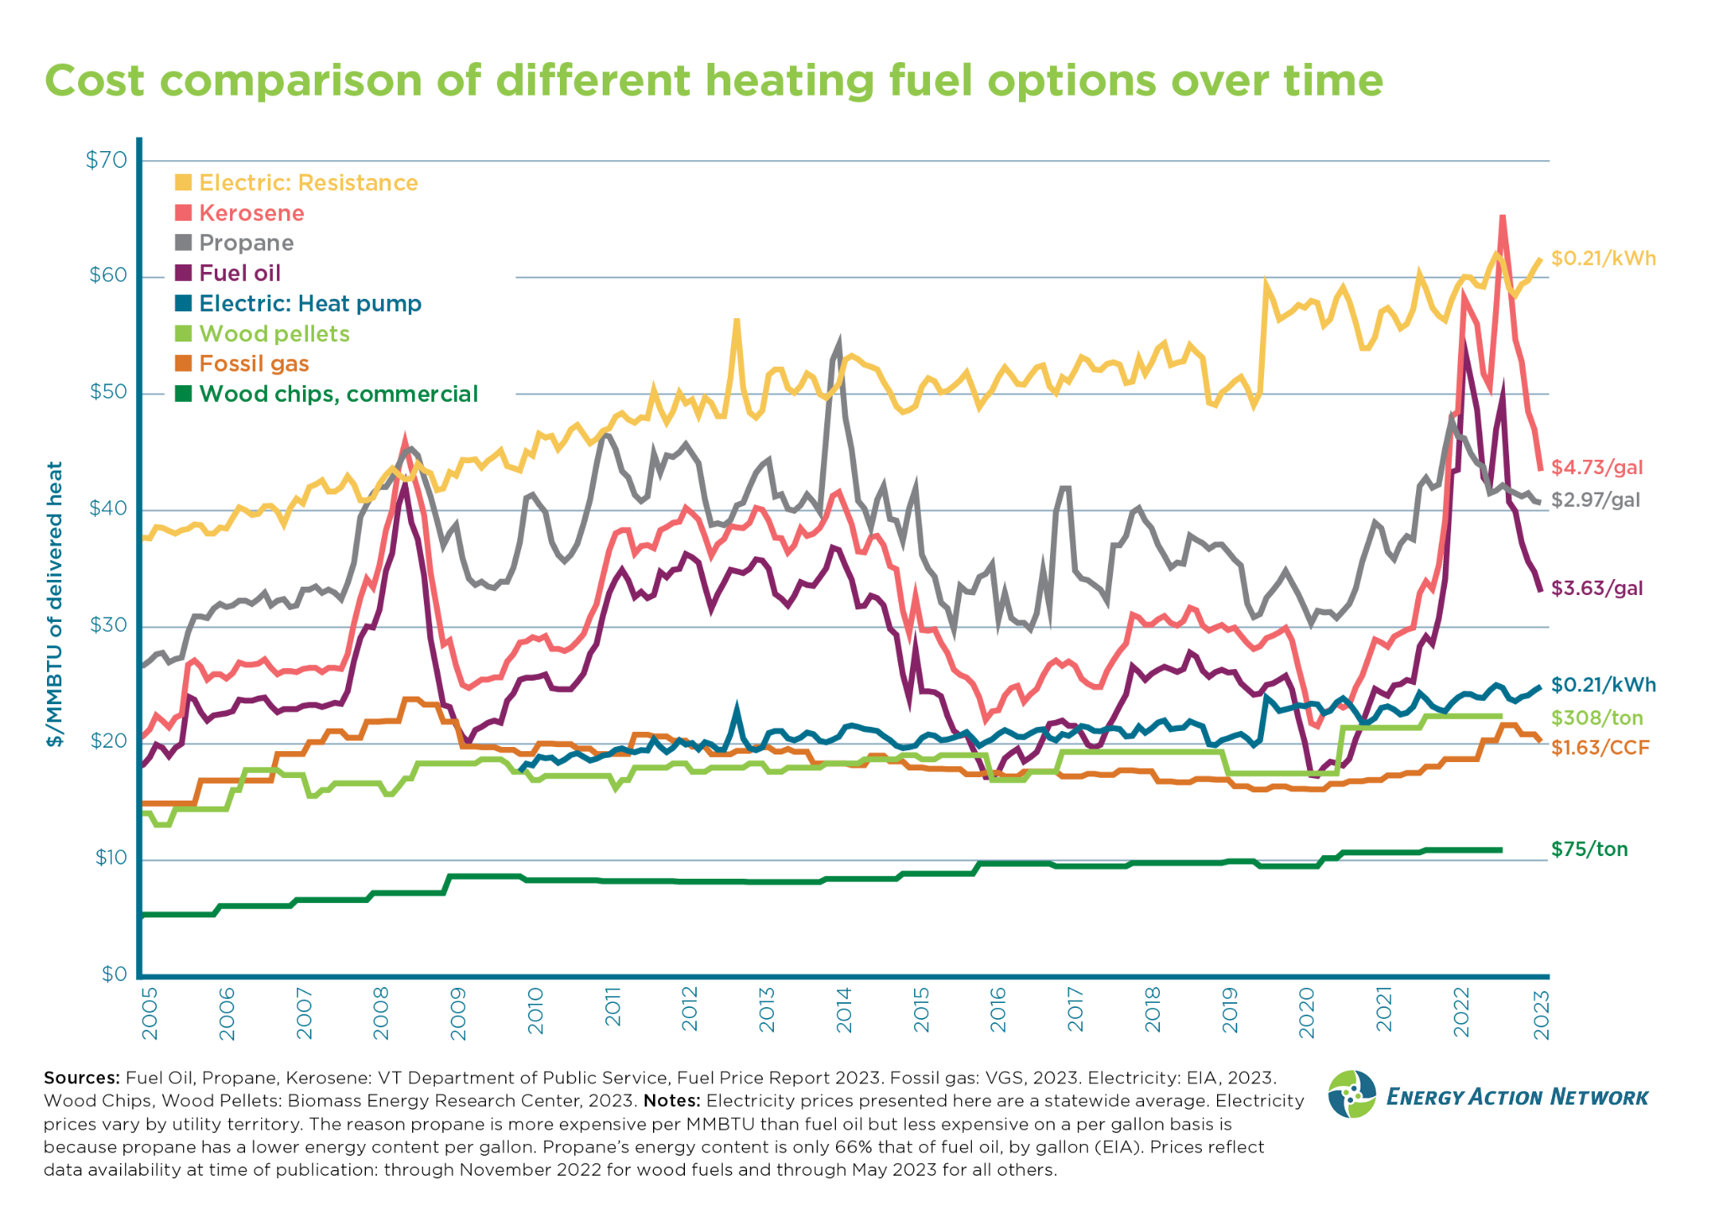
Notes:
Jared
Similarly on the heating side, this graph compares the cost of different heating fuels in Vermont. As you can see, the prices for fuel oil, propane, and kerosene (as shown in purple, pink, and grey) are, on average, much higher than other heating options and also experience much greater price volatility. In contrast, using heat pumps for heating is a much less expensive and more price stable option, as shown in the dark blue line.

Slide 26
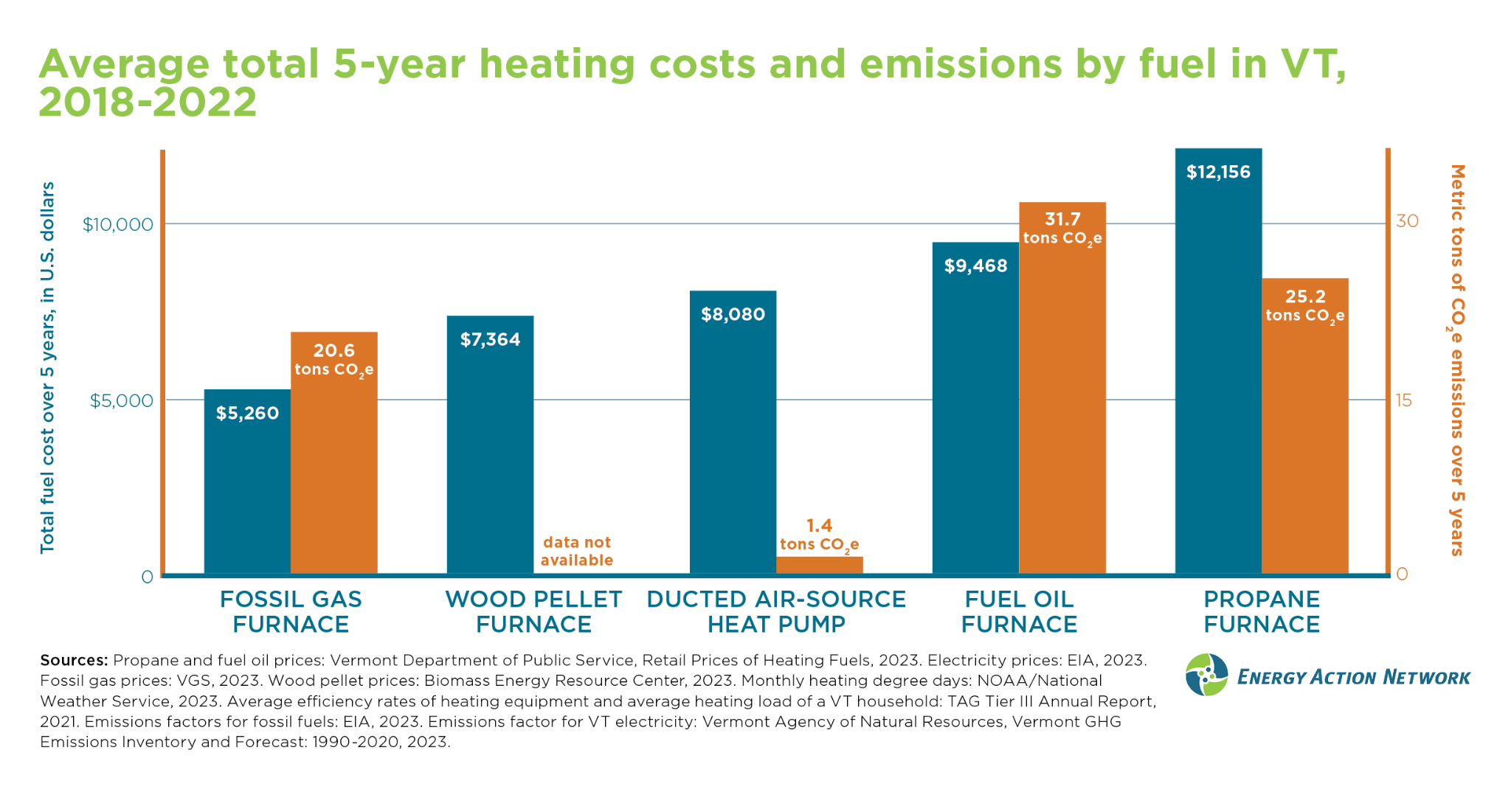
Notes:
Jared
Here we show the estimated total fuel costs for the average Vermont household over the last 5 years, depending on the heating source. As you can see, the most expensive heating fuel options have been fuel oil and propane. Note: given the variation in installation costs and the question of time of replacement, this graph does not account for the costs of equipment installation associated with these various heating options and is just a fuel cost comparison.

Slide 27
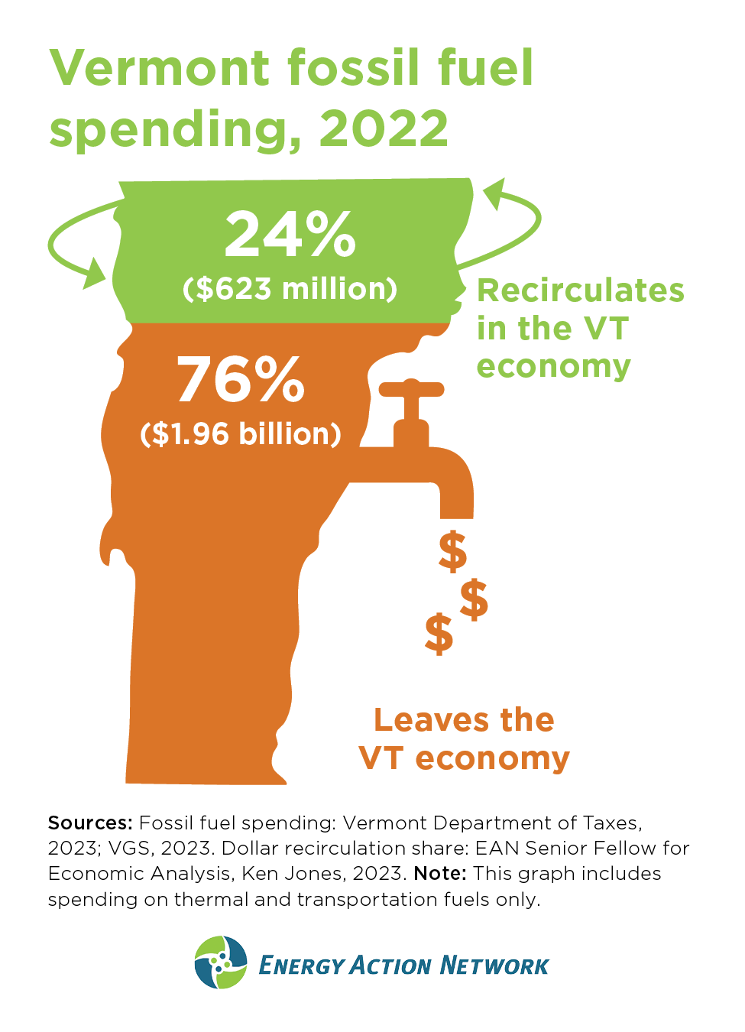
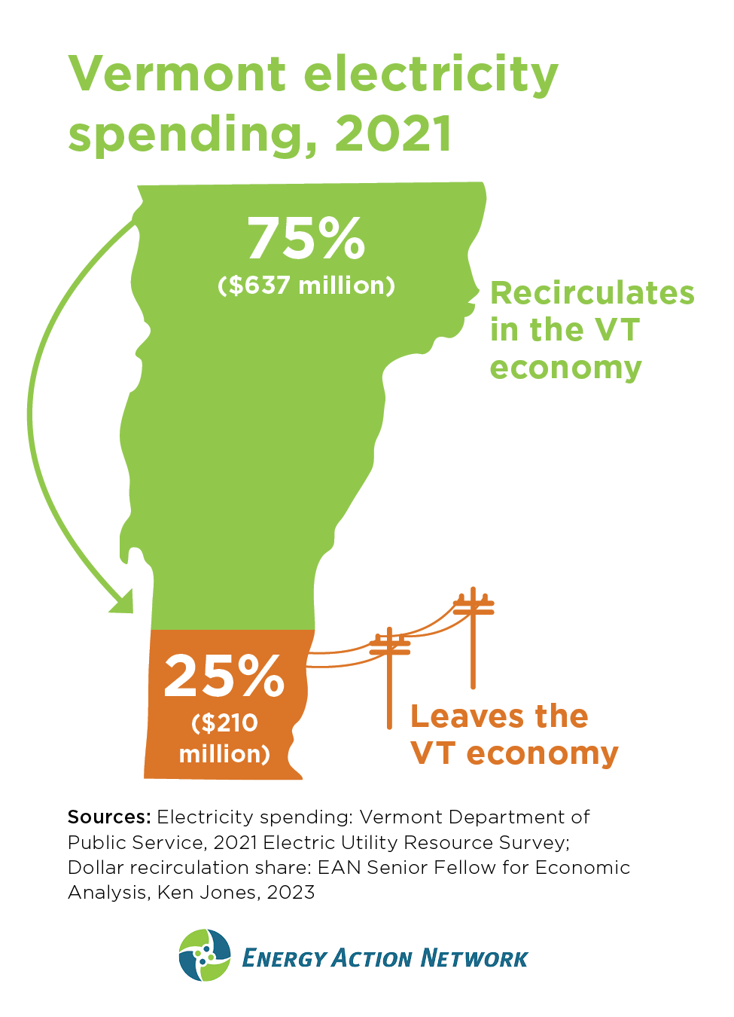
Notes:
Jared
Beyond important individual and household economic considerations, there are also important opportunities for state economies. Again, specific to Vermont, a move from 100% imported fossil fuel – where 76 cents of every dollar we spend on it drains out of the state economy to pay for the cost of the imported commodity product – to electricity flips that dollar flow on its head, keeping three quarters of our energy dollars staying and recirculating in state. This is because much of the cost of electricity goes toward paying local lineworkers, tree trimmers, and clean power producers. In this way we can re-invest billions in our state economy and help support jobs for our neighbors.

Slide 28
Key Findings Summary - New England
Per capita emissions are an important metric for comparison between jurisdictions. New Hampshire and Vermont emit the most and 2nd most climate pollution per person in New England.
Climate responsibility should be evaluated through the lens of justice and equity.
Effective mitigation of climate pollution requires cooperation and collective action. When one jurisdiction doesn’t do its part, it can create a domino effect and stall effective action elsewhere.
All states have a responsibility to do their part to reduce emissions produced within their state.
Notes:
Lena
Per capita emissions are an important metric for comparison between jurisdictions. New Hampshire and Vermont emit the most and 2nd most climate pollution more per person in New England.
This is not to say that
Climate responsibility should be evaluated through the lens of justice and equity.
Effective mitigation of climate pollution requires cooperation and collective action. When one jurisdiction doesn’t do its part, it can create a domino effect and stall effective action elsewhere.
All states have a responsibility to do their part to reduce emissions produced within their state.

Slide 29
Key Findings Summary - Vermont
Vermont has made the least progress toward the 2025 target of the Paris Agreement (and VT’s Global Warming Solutions Act) of any state in the Northeast (11% below 2005 levels as of 2019 vs. 26% required reduction).
Vermont’s per capita emissions are the 3rd highest in the Northeast, with only PA and NH emitting more climate pollution per person.
Vermont’s per capita emissions (~14 tons/person) are more than two times higher than the global average (~6 tons/person).
Vermont’s estimated cumulative GHG pollution since 1850 is higher than over 70 countries, many of which have higher populations.
Moving beyond fossil fuels toward cleaner and more efficient energy is a major opportunity to save Vermonters money and to strengthen the Vermont economy.
Notes:
Lena

Slide 30
The report, webinar recording, and presentation slides will be available at https://www.eanvt.org/research-and-reports/report-vt-climate-responsibility/
For questions or to request a presentation contact:
lena@eanvt.org
Notes:
Lena
If you would like to schedule a presentation and discussion with us for your organization, either about this research paper or our Annual Progress Report for Vermont, please let us know. And if you have any questions, we are happy to address them, both now and going forward.
We are always working to find new ways to make our research and analysis as clear and accessible as possible. We always welcome constructive feedback on ways that we can improve our publications and presentations and on additional topics that you think would benefit from EAN research and analysis. With that, we are now eager to hear from you. Cara, what questions do we have?

Slide 31
